Slide 1
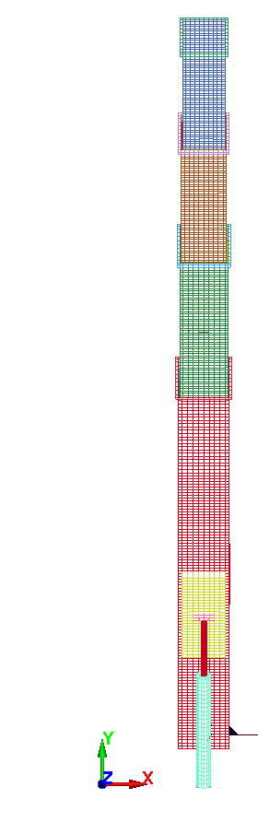
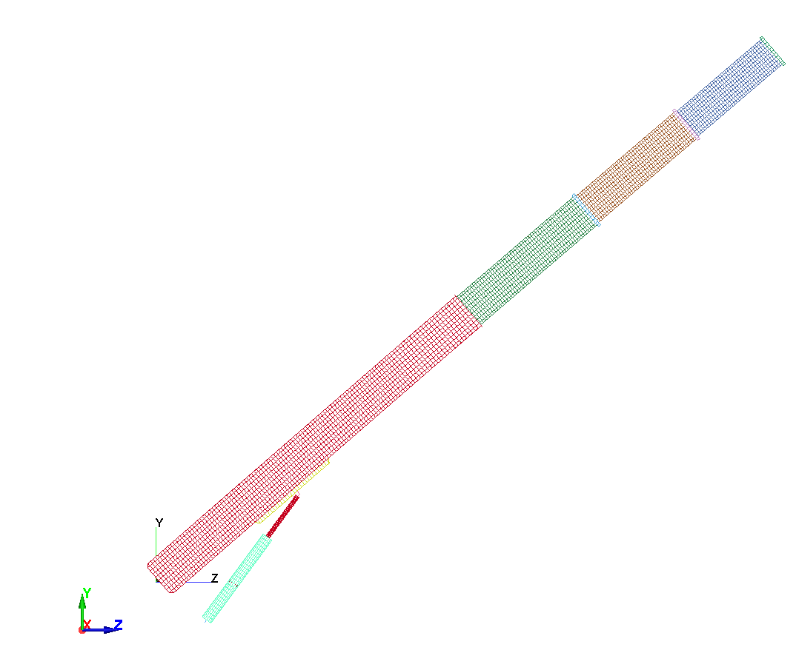
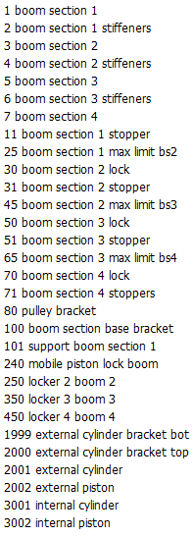

CRANE 4 BOOMS MODEL_B 3D LAG CSYS
Initial Crane Angle = 47.1545
Hook
Load
(1500N)
Boom
Extension
Gravity Load
(Weight)
Boom
Rotation
UNITS : m:kg:s:Pa:N:K

Slide 2
SCENARIOS BOOM VARIABLE INITIAL PID FUNCTIONAL
ROTATION EXTENSION CONFIGURATION LOAD CONTROLLER MOCKUP(FMU)
MODEL_A YES YES HORIZONTAL GRAVITY NO NO
MODEL_B NO NO ANGLE + GRAVITY + NO NO
EXTENSION HOOK
MODEL_C NO NO ANGLE + GRAVITY + YES NON WRAPPER
EXTENSION HOOK (PROPORTIONAL)
MODEL_D NO NO ANGLE + GRAVITY + YES WRAPPER
EXTENSION HOOK (PROPORTIONAL)
NB
Model _B scenario has gravity and hook load applied and the data is valid up to 1.5s.
The booms are in a fixed configuration (ie angle and extension).
SPC are applied to the connection between the external piston and boom section 1.
No Actuator and P Controller are included.

Slide 3
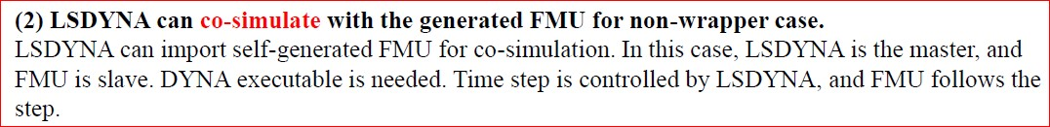
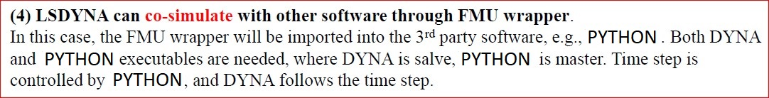
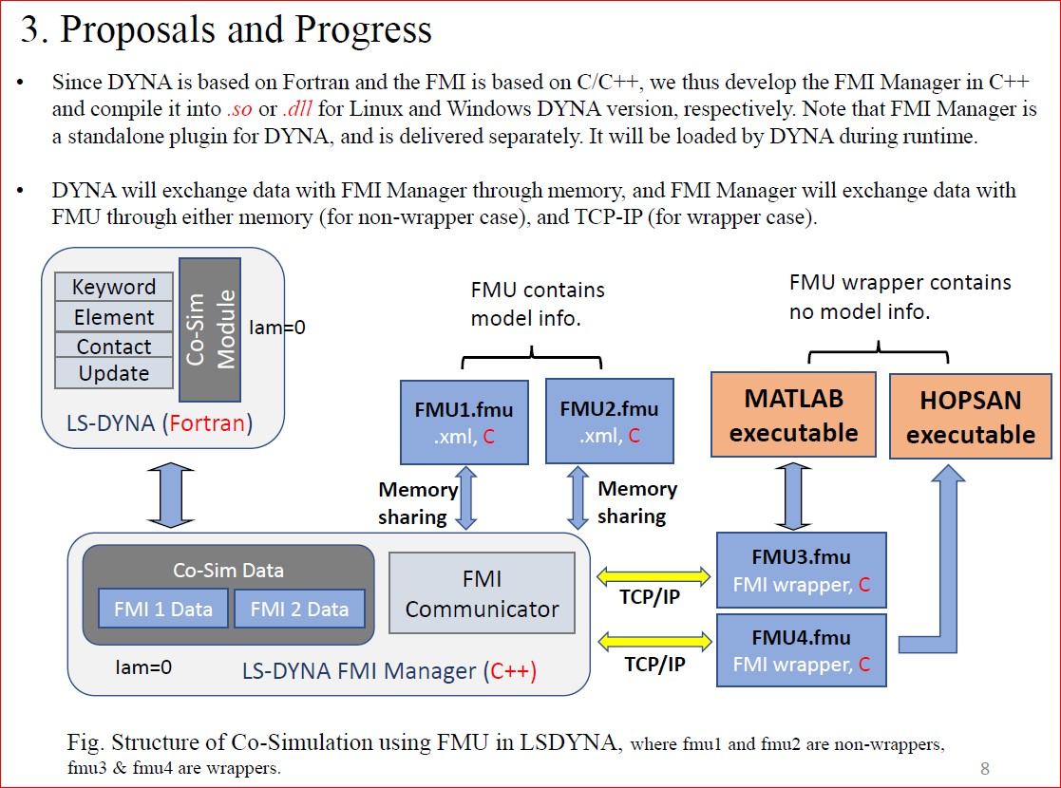
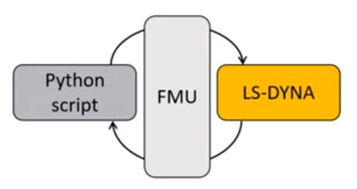
COSIMULATION TERMINOLGY
NON-WRAPPERS
NB. WRAPPER SCENARIO
WRAPPERS
PRIMARY
(MASTER)
SECONDARY
(SLAVE)

Slide 4
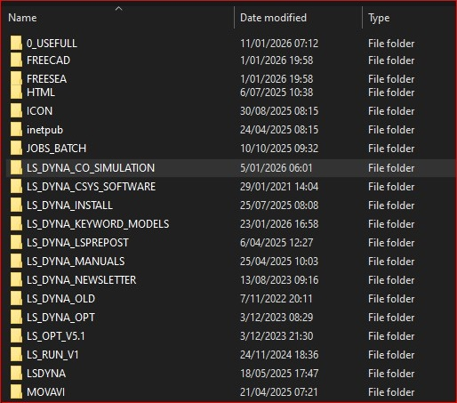
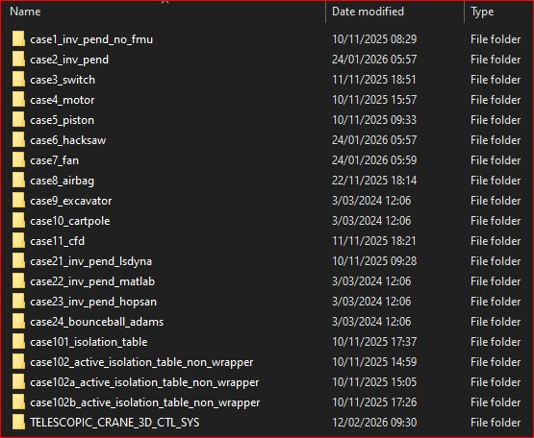
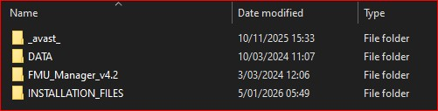
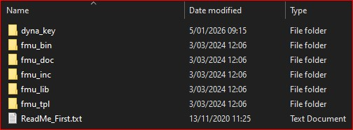
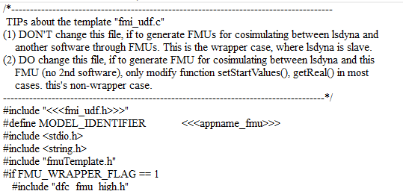
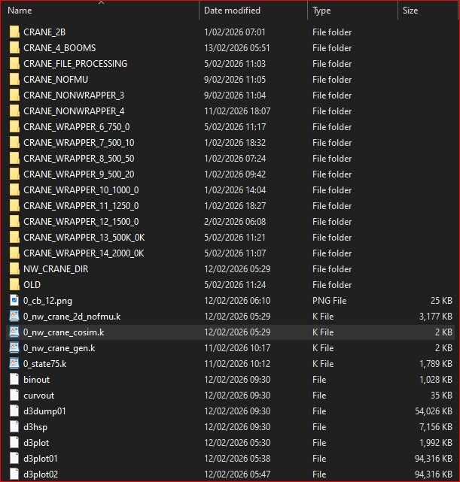
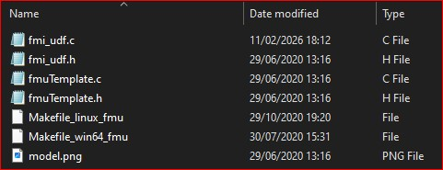
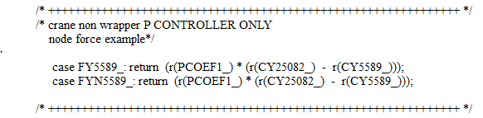
FOLDER STRUCTURE
etc
etc

Slide 5
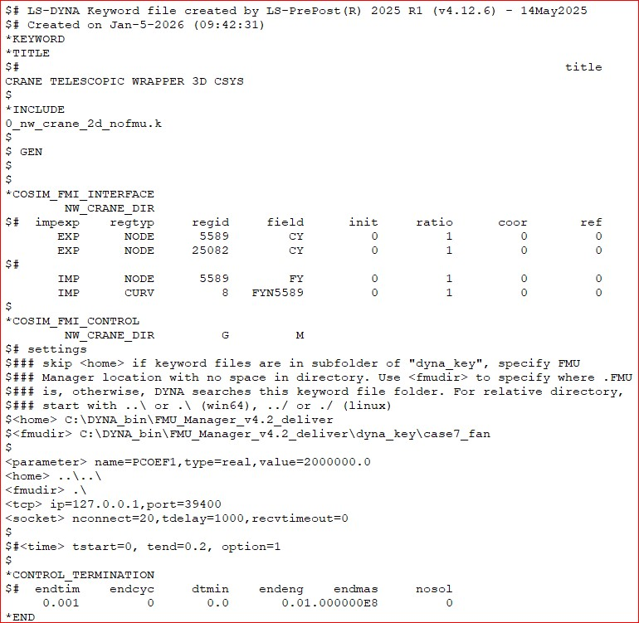
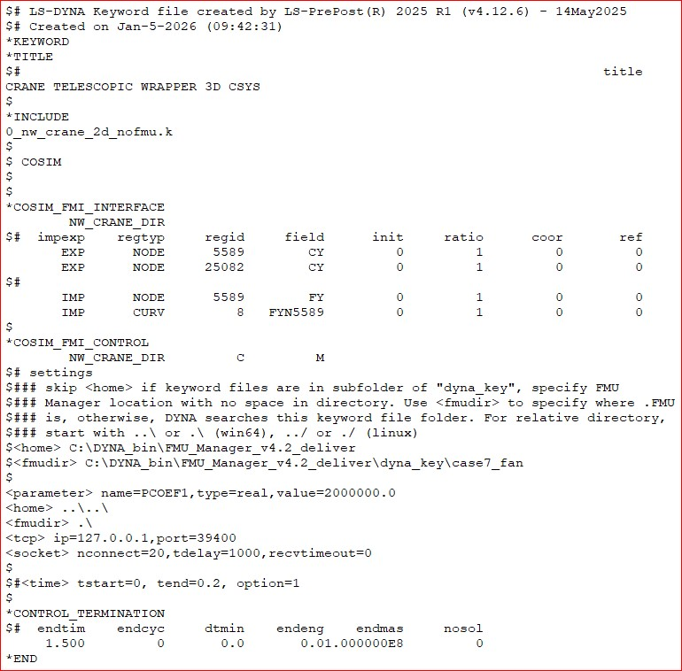
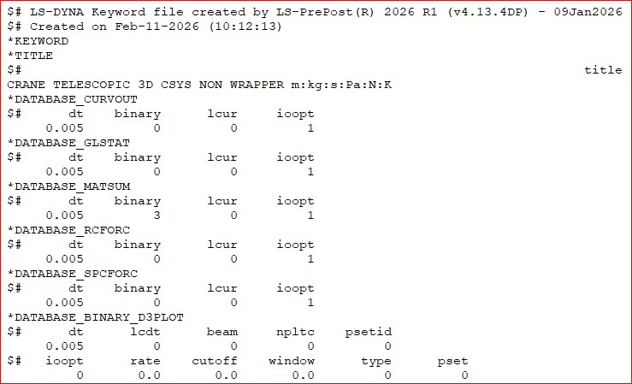
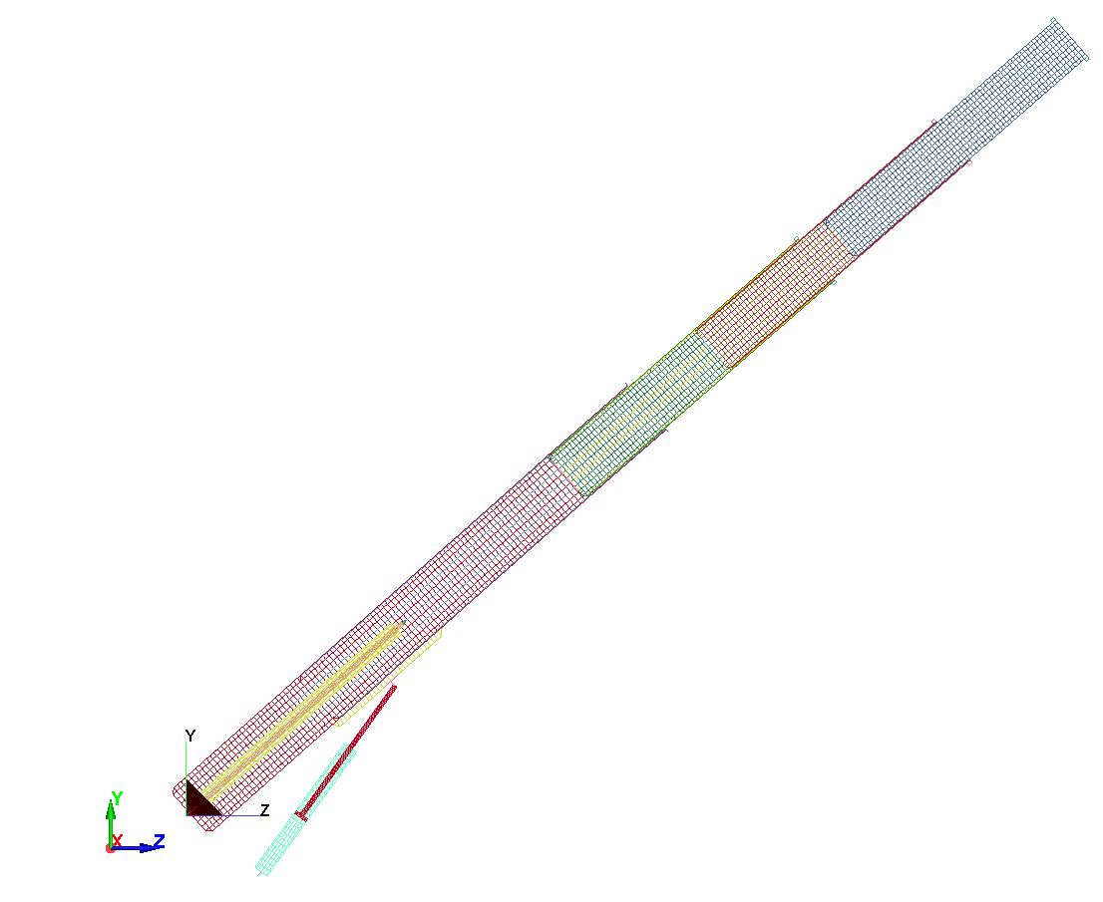

LS_DYNA FILES FOR COSIMULATION
etc
Initial Crane Angle = 47.1545

Slide 6
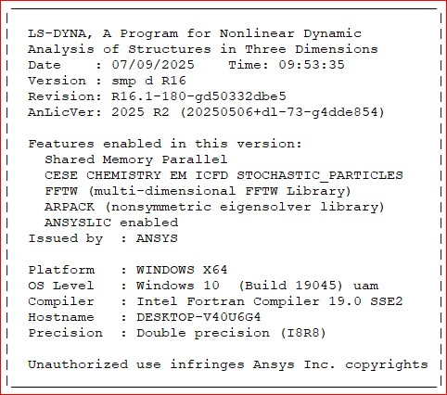
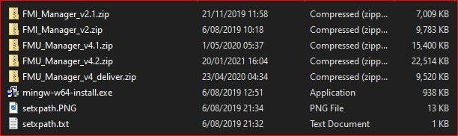

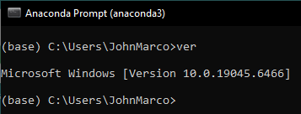
SOFTWARE INSTALLATION
Pyfmi version 2.9.5
Anaconda version 2020.11

Slide 7
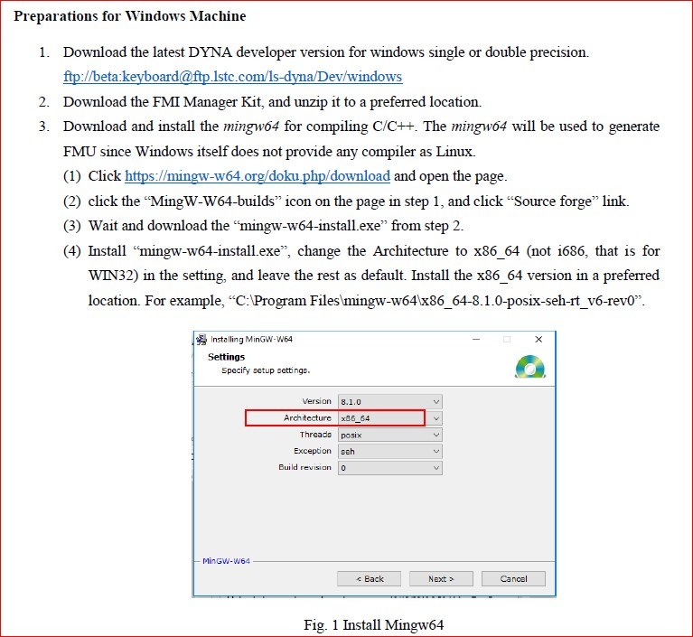
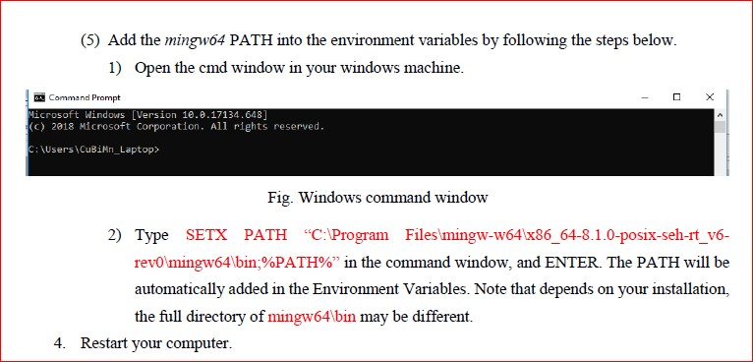
HOW TO INSTALL

Slide 8
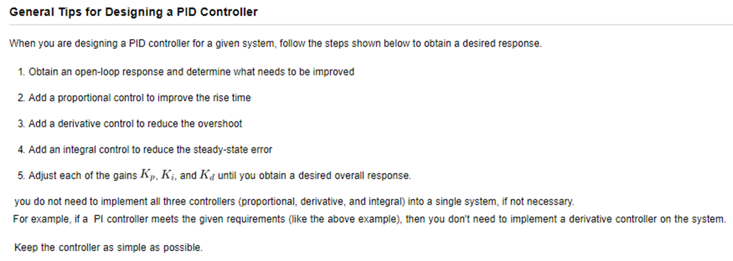
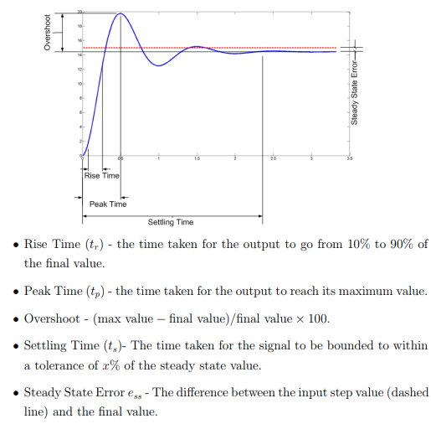
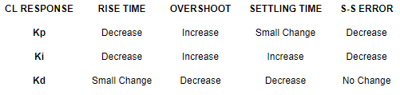

Slide 9
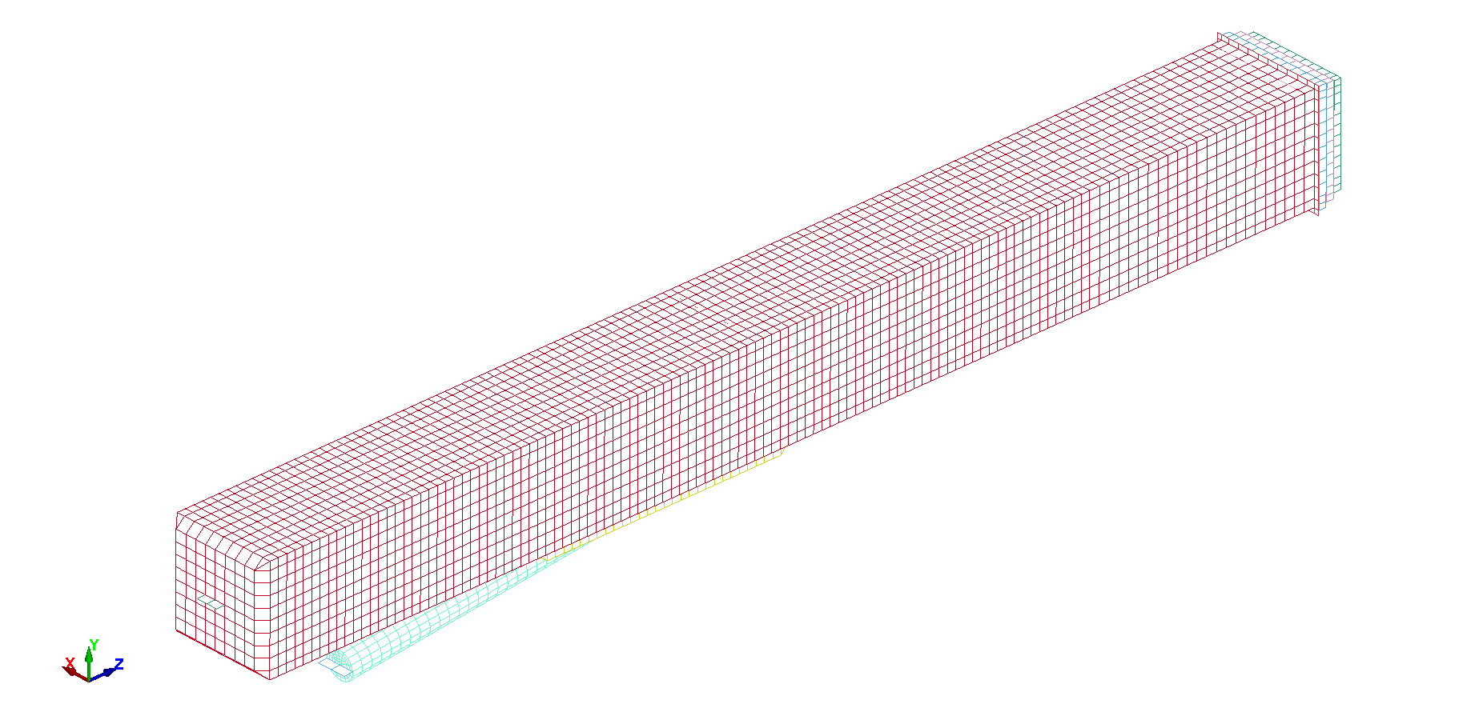
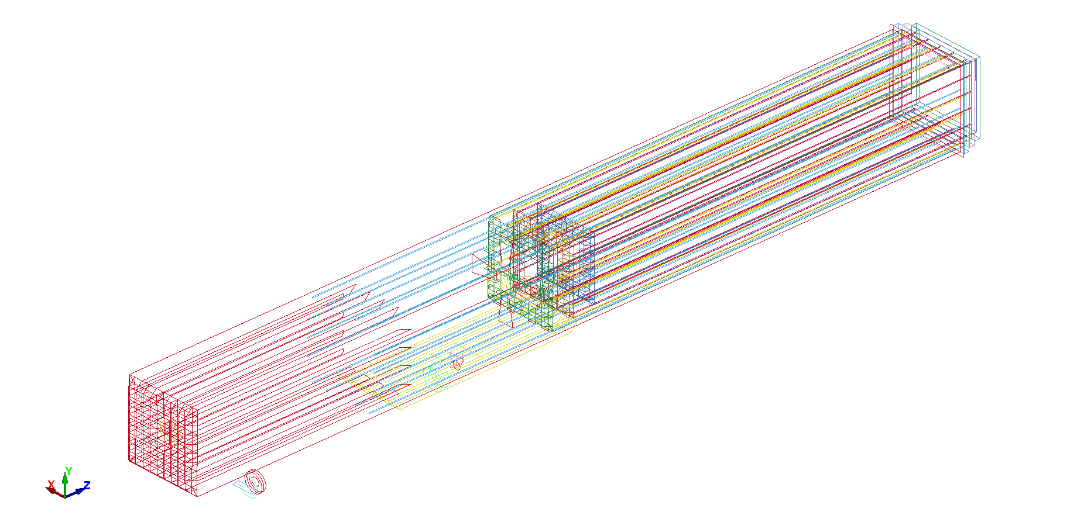
GEOMETRY
(AVERAGE)
BOOM WIDTH HEIGHT THICKNESS LENGTH STIFFENERS WIDTH HEIGHT
  0.358 0.358 0.005 3.745 1 0.005 0.005
  0.338 0.338 0.005 2.025 2 0.005 0.005
  0.318 0.318 0.005 1.950 3 0.005 0.0045
  0.299 0.299 0.005 1.876

Slide 10
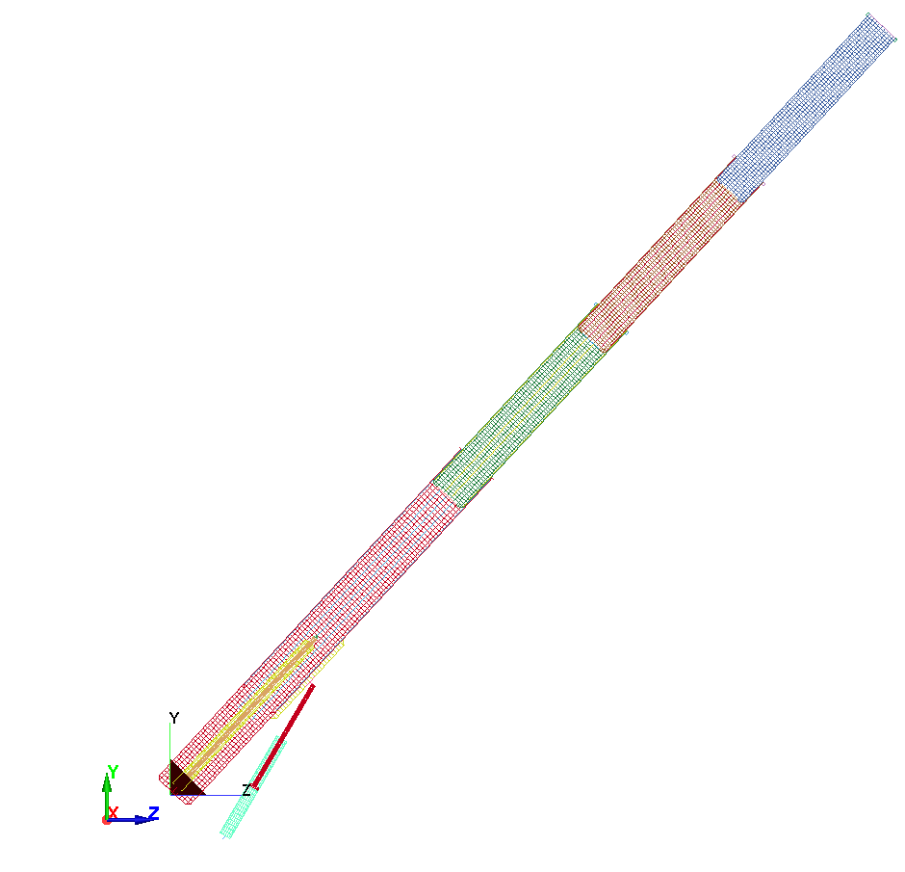
INTERNAL & EXTERNAL PISTON/CYLINDER PARTS
(Not All Parts in Crane Model B are used in the Calculations)
Initial Crane Angle = 47.1545
NB Initial Configuration

Slide 11
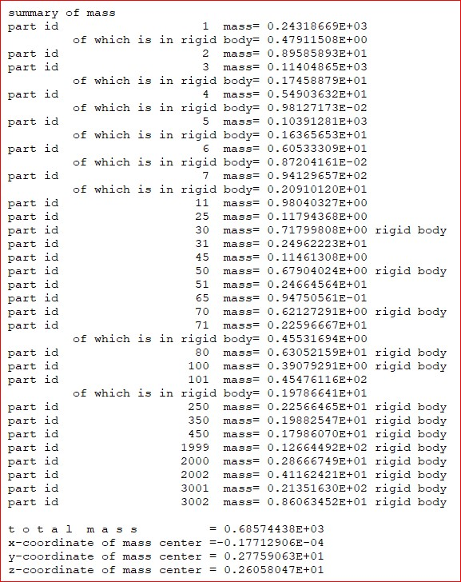
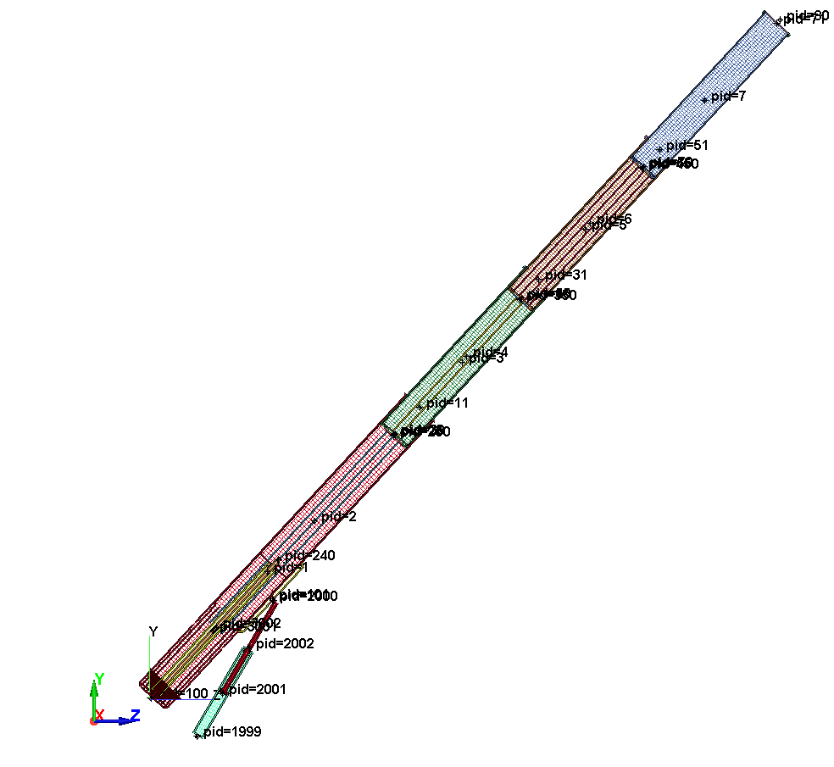
Initial Crane Angle = 47.1545

Slide 12
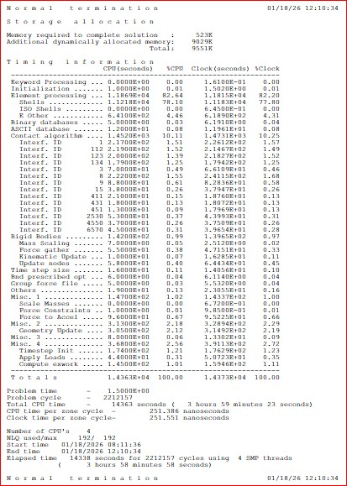
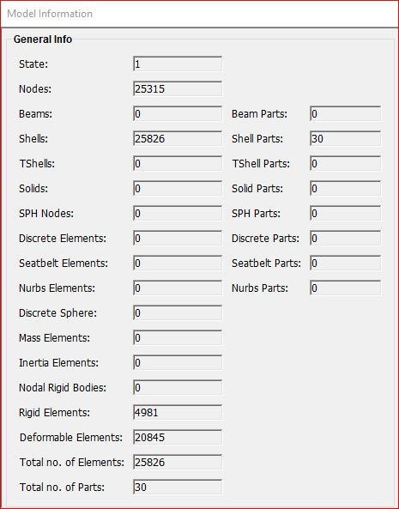
SCENARIO B

Slide 13
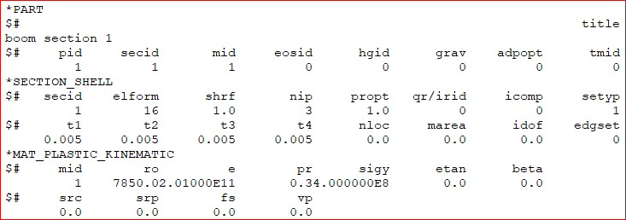
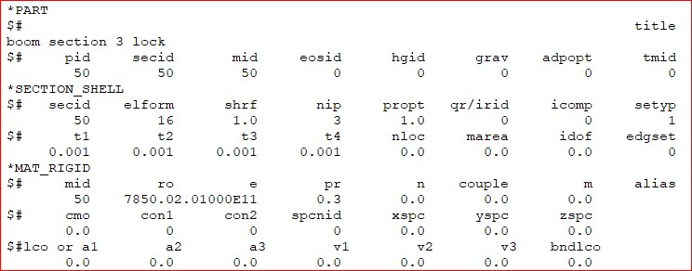
TYPICAL PARTS
ELASTIC/PLASTIC
RIGID

Slide 14
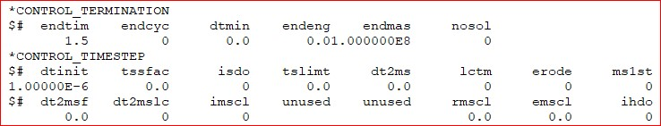
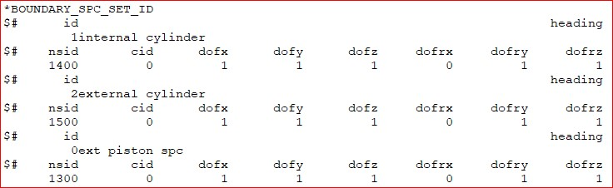
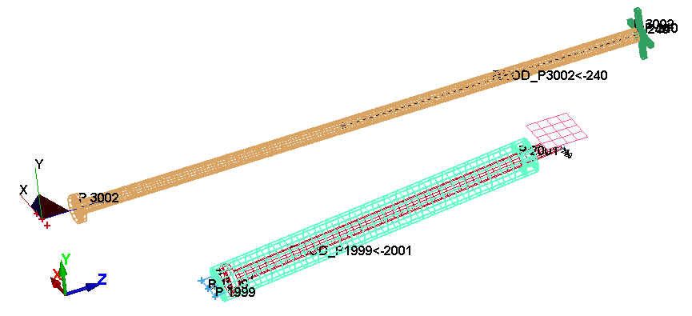
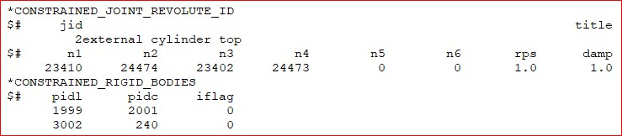
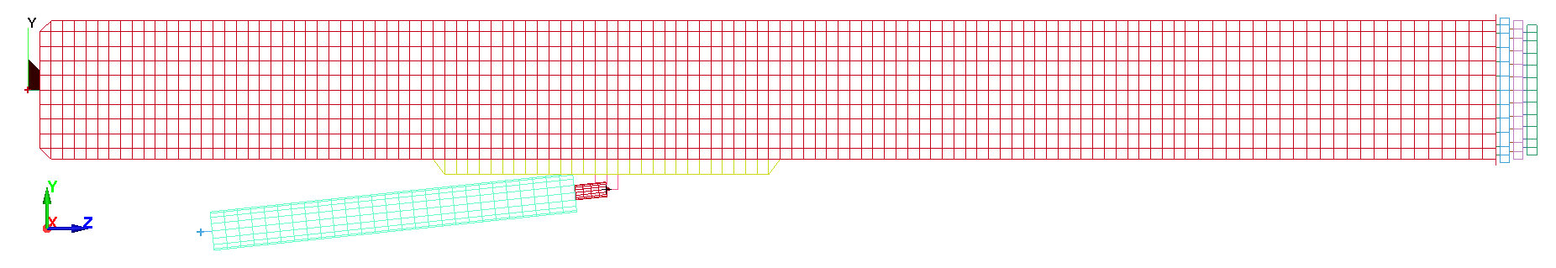
KEYWORDS CONTROL
KEYWORDS BOUNDARY CONDITION
KEYWORDS CONSTRAINTS

Slide 15
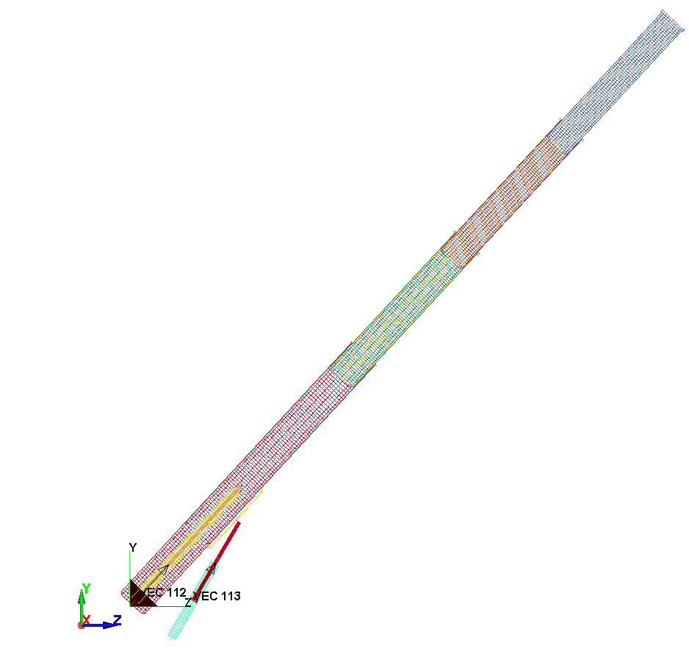
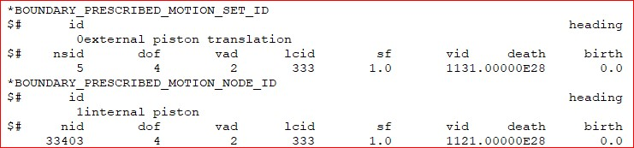
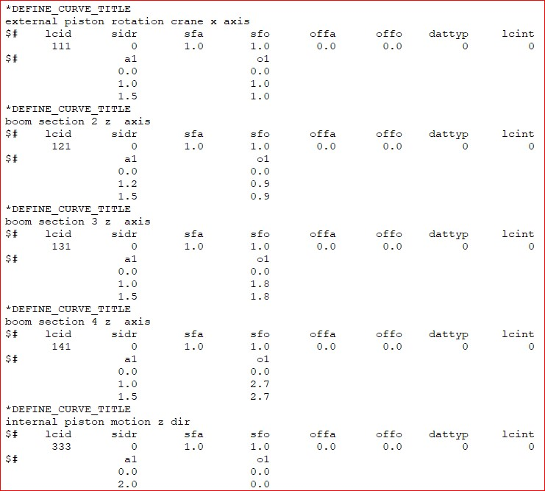
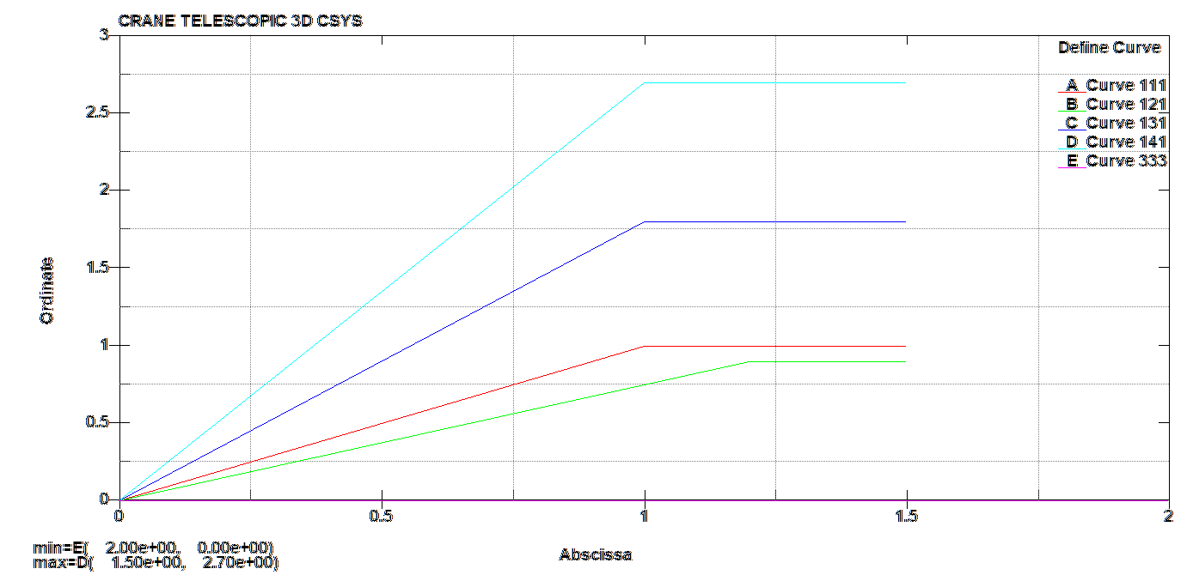
KEYWORDS BOUNDARY PRESCRIBED MOTION
Initial Crane Angle = 47.1545
BOOM EXTENSION

Slide 16
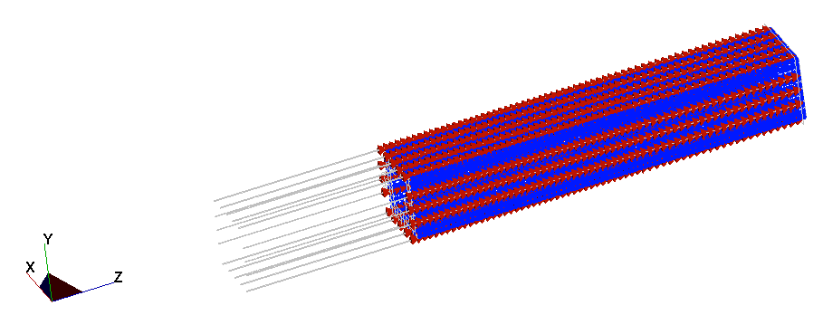
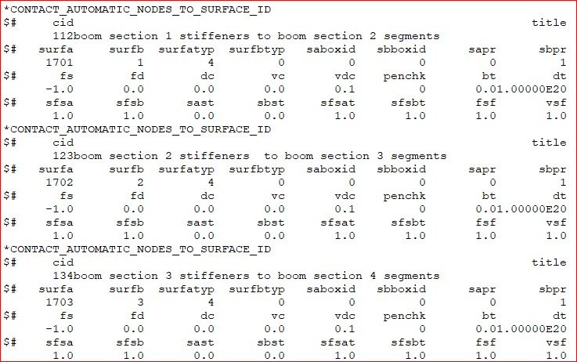
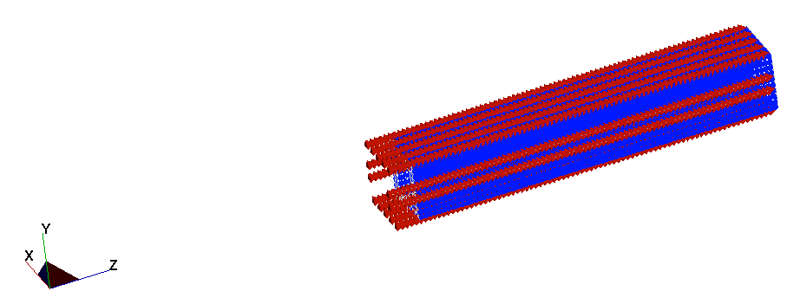
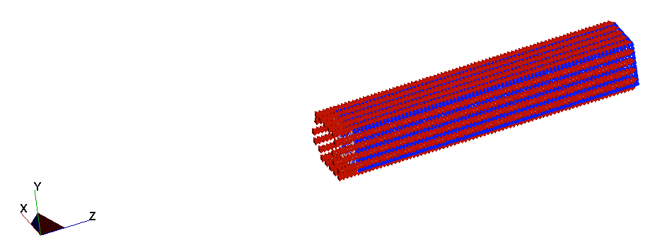
KEYWORDS CONTACT 1
Boom 2
CONTACT 112
Boom 1 Stiffeners
Boom 3
CONTACT 123
Boom 2 Stiffeners
CONTACT 134
Boom 4
Boom 3 Stiffeners

Slide 17
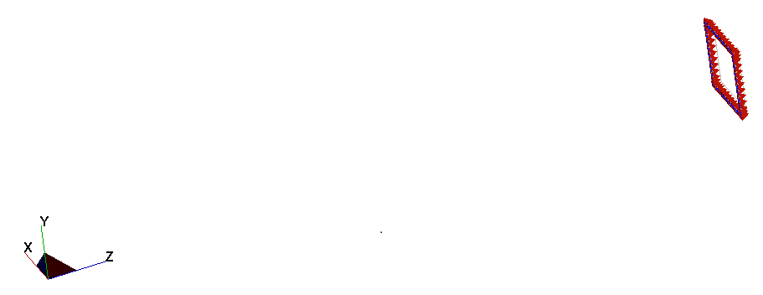




KEYWORDS CONTACT 2
CONTACT 411
CONTACT 431
CONTACT 451

Slide 18



KEYWORDS CONTACT 3
Initial Crane Angle = 47.1545
CONTACT 6570
CONTACT 4550
CONTACT 2530

Slide 19





KEYWORD GRAVITY & HOOK LOADS
Hook Load = 1500N
LOADING CURVE
Hook
Load
Gravity Load
Initial Crane Angle = 47.1545

Slide 20




RESULTS NODE TRACE
Initial Crane Angle = 47.1545
Fixed
Angle Vibration About Initial Crane Angle
Fixed

Slide 21


BOOM ROTATION & EXTENSIONS
Hook Load (1500N)
NB Crane Booms Fixed in Rotation and Extension
Initial Crane Angle = 47.1545
Boom
Extension
Boom
Rotation

Slide 22





BOUNDARY CONSTRAINT FORCES
X, Y & Z FORCES
FILTERED BW 60Hz
TOTAL FORCE
FILTERED BW 60Hz
Initial Crane Angle = 47.1545

Slide 23



CONTACTS
These Contacts are between a Boom Section and a Boom Stiffener
Boom 4
Boom 3 Stiffeners
Boom 3
Boom 2
Boom 2 Stiffeners
Boom 1 Stiffeners
FILTERED BW 60Hz
Initial Crane Angle = 47.1545

Slide 24


CONTACTS
NB These Contacts prevent The Boom Sections from Retracting
Boom 4 Lock
Boom 3 Stiffeners Max Limit
Boom 3 Lock
Boom 2 Stiffeners Max Limit
Boom 2 Lock
Boom 1 Stiffeners Max Limit
Initial Crane Angle = 47.1545

Slide 25



VON MISES STRESS

