Slide 1
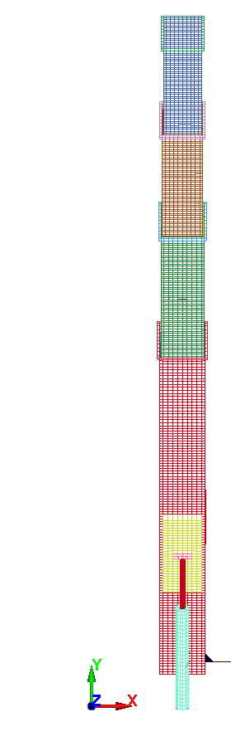
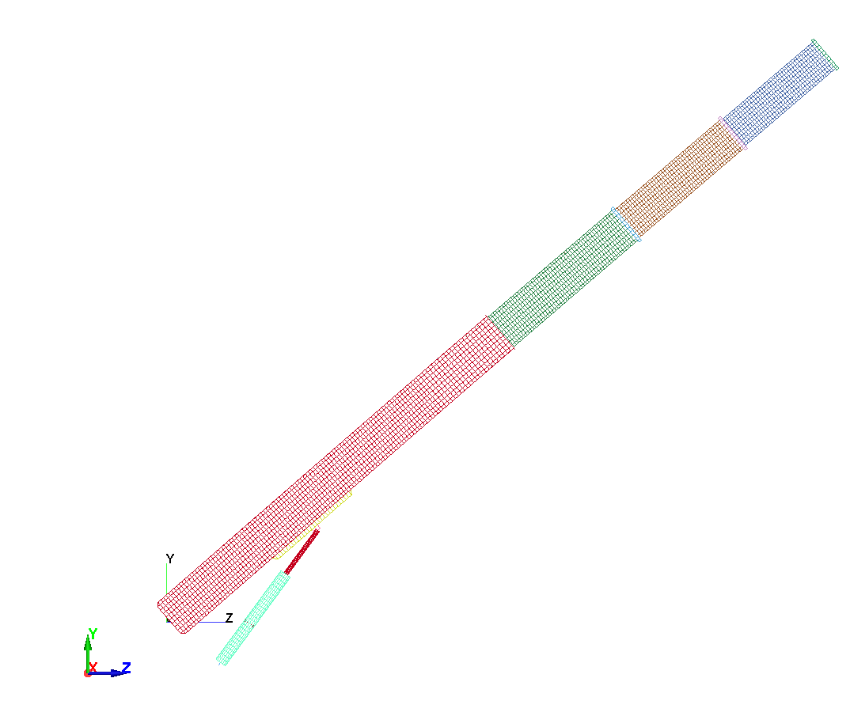
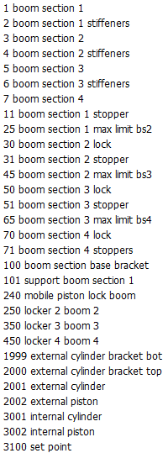
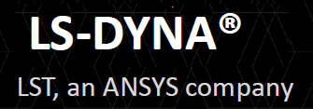
CRANE 4 BOOMS MODEL_C_D 3D LAG CSYS
Initial Crane Angle = ~40
Hook
Load
(400N)
(COMPARISON BETWEEN NON WRAPPER[C] & WRAPPER[D] SCENARIO)
Boom
Extension
Fixed
Gravity Load
(Weight)
Boom
Rotation
Fixed
Actuator
P Controlled
UNITS : m:kg:s:Pa:N:K

Slide 2
SCENARIOS BOOM VARIABLE INITIAL PID FUNCTIONAL
ROTATION EXTENSION CONFIGURATION LOAD CONTROLLER MOCKUP(FMU)
MODEL_A YES YES HORIZONTAL GRAVITY NO NO
MODEL_B NO NO ANGLE + GRAVITY + NO NO
EXTENSION HOOK
MODEL_C NO NO ANGLE + GRAVITY + YES NON WRAPPER
EXTENSION HOOK (PROPORTIONAL)
MODEL_D NO NO ANGLE + GRAVITY + YES WRAPPER
EXTENSION HOOK (PROPORTIONAL)
NB
Models_C_D the internal and external cylinders/pistons are not functional.
Models _C_D has gravity and hook load applied and the data is valid up to 1.5s.
The booms are in a fixed configuration (ie angle and extension).
A vertical actuator is positioned at the connection point between the external piston and boom section 1.
This actuator has a P Controller and holds the crane at the given initial angle(~40deg) of the crane boom.
Non Wrapper & Wrapper scenario. Force by actuator holds up the crane booms.

Slide 3
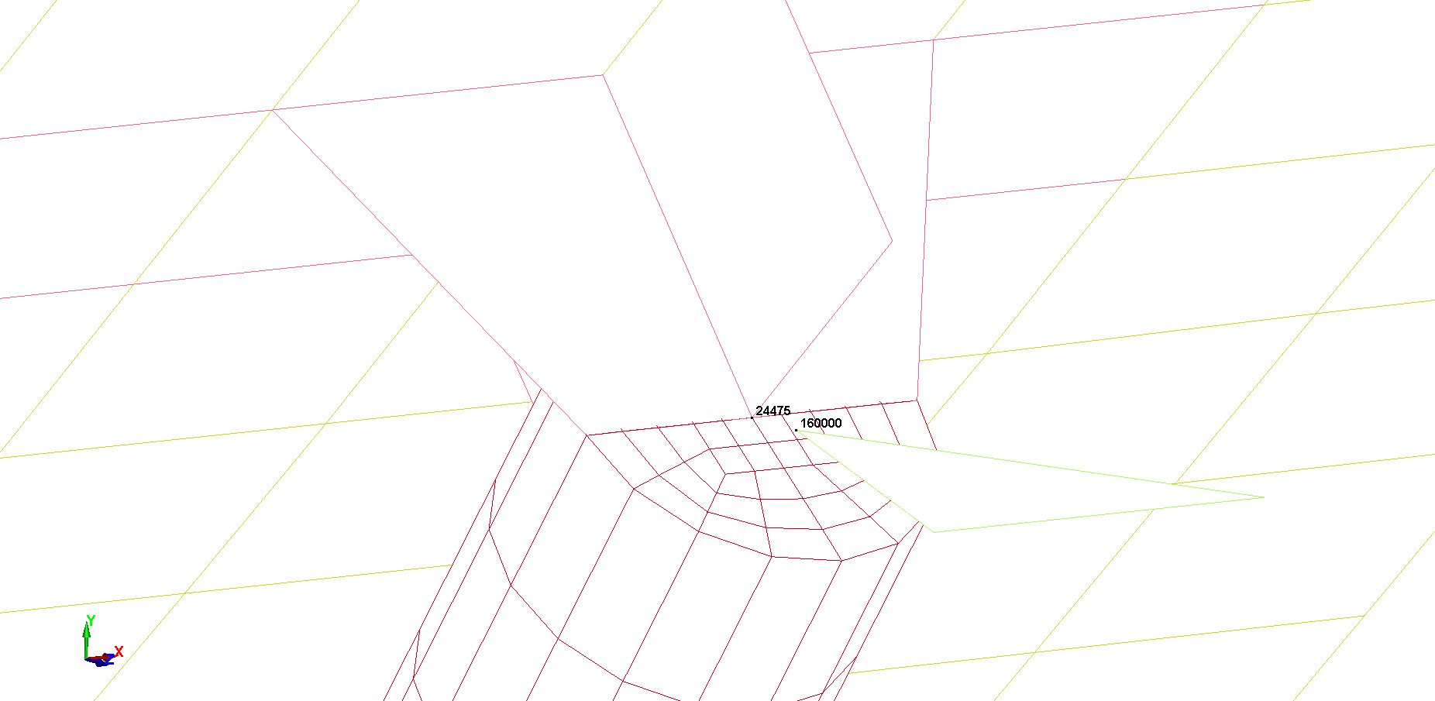
NB The Y direction difference between NID 160000 and NID 24475 is to be kept to a minimum via the P Controller
P CONTROLLER POINT
SET POINT
ACTUATOR

Slide 4
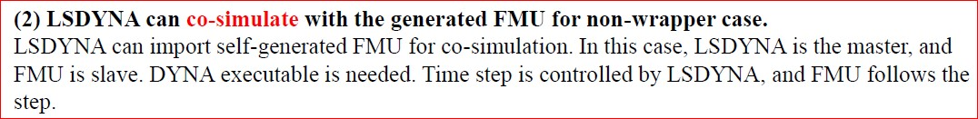
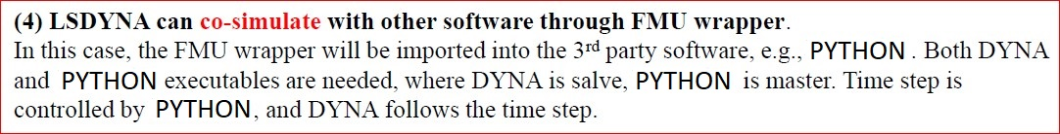
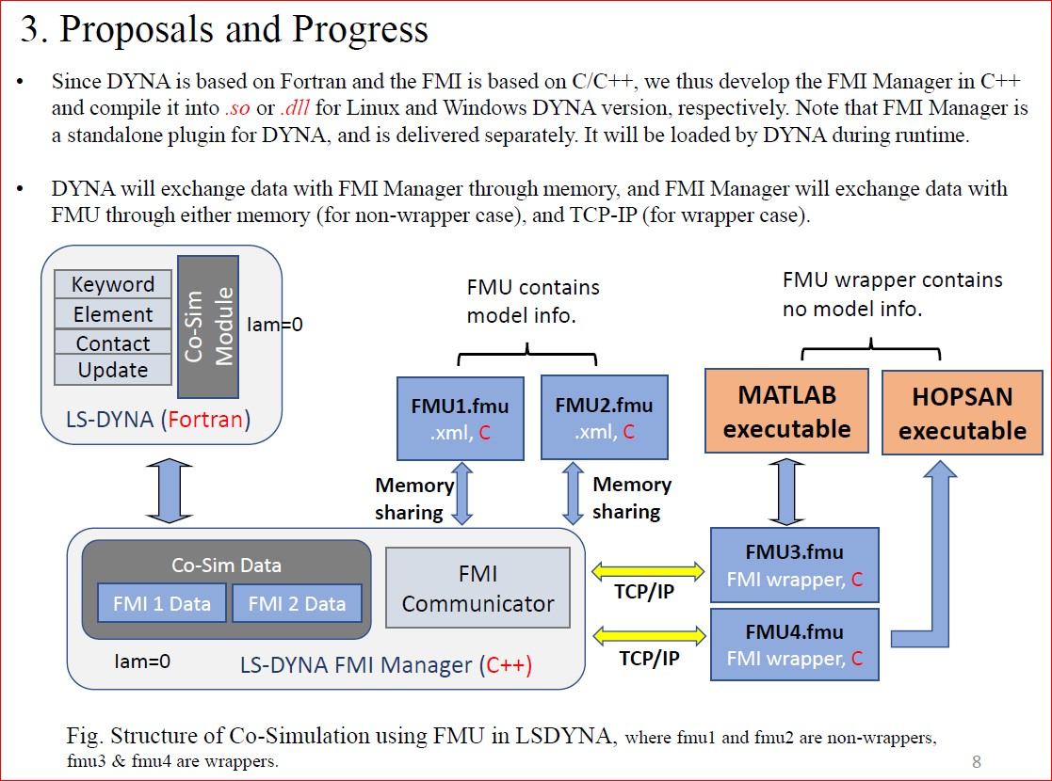
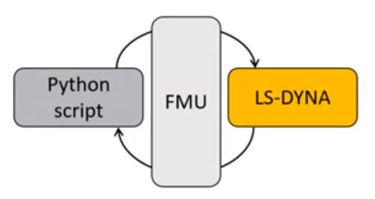
COSIMULATION TERMINOLGY
NON-WRAPPERS
NB. WRAPPER SCENARIO
WRAPPERS
PRIMARY
(MASTER)
SECONDARY
(SLAVE)

Slide 5
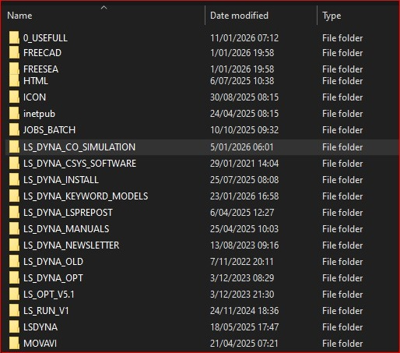
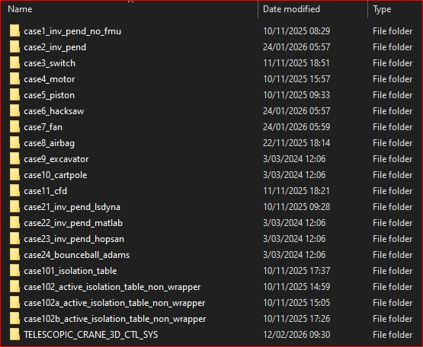
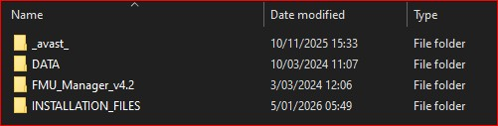
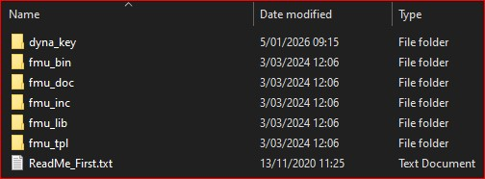
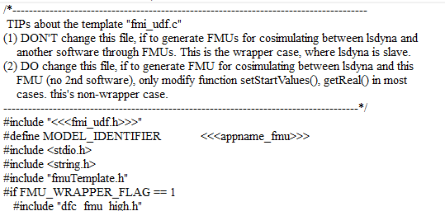
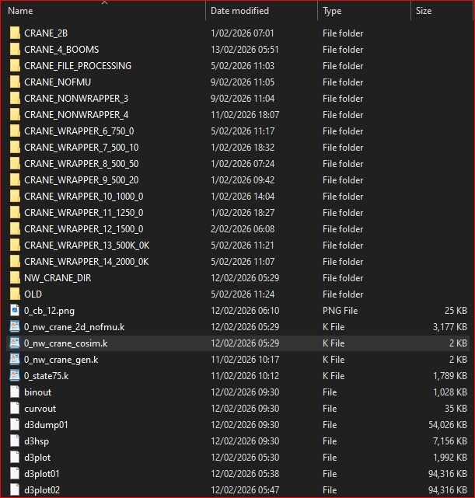
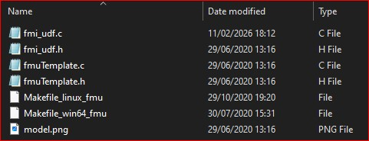
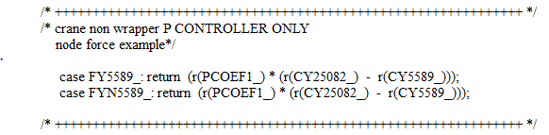
FOLDER STRUCTURE
etc
etc

Slide 6

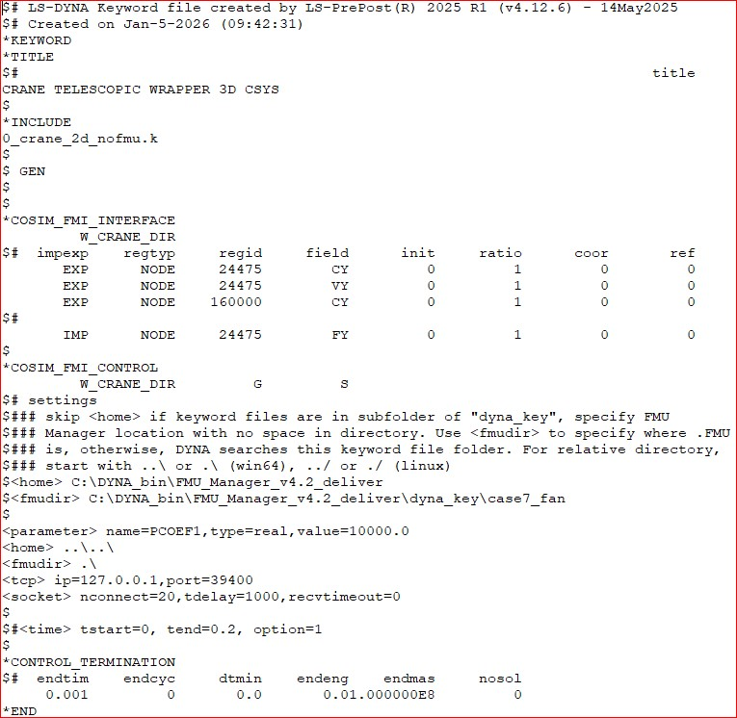
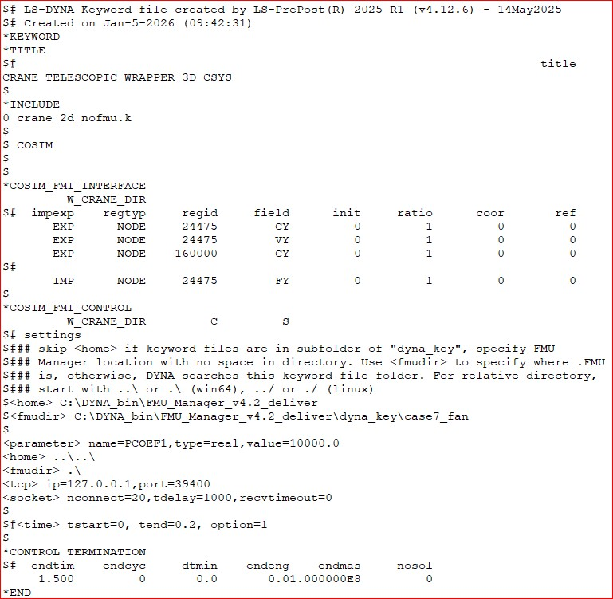
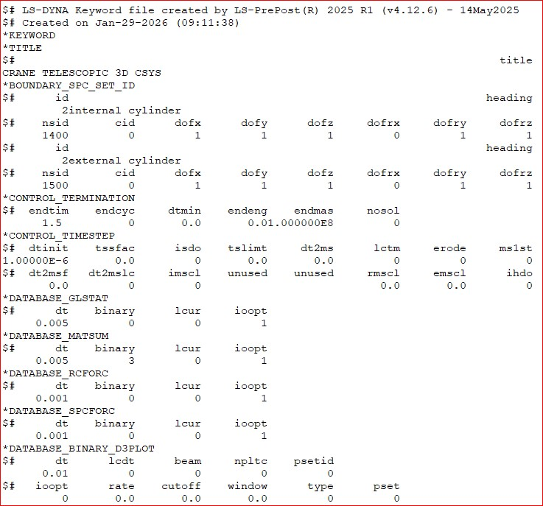
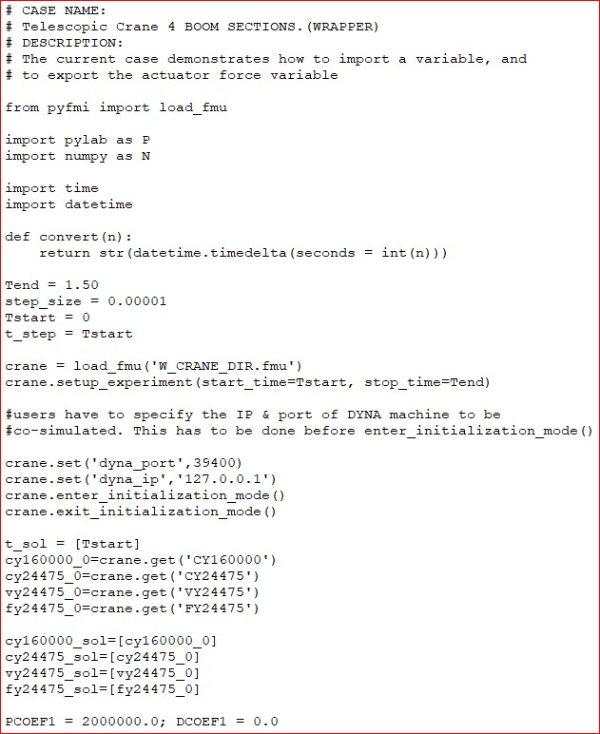
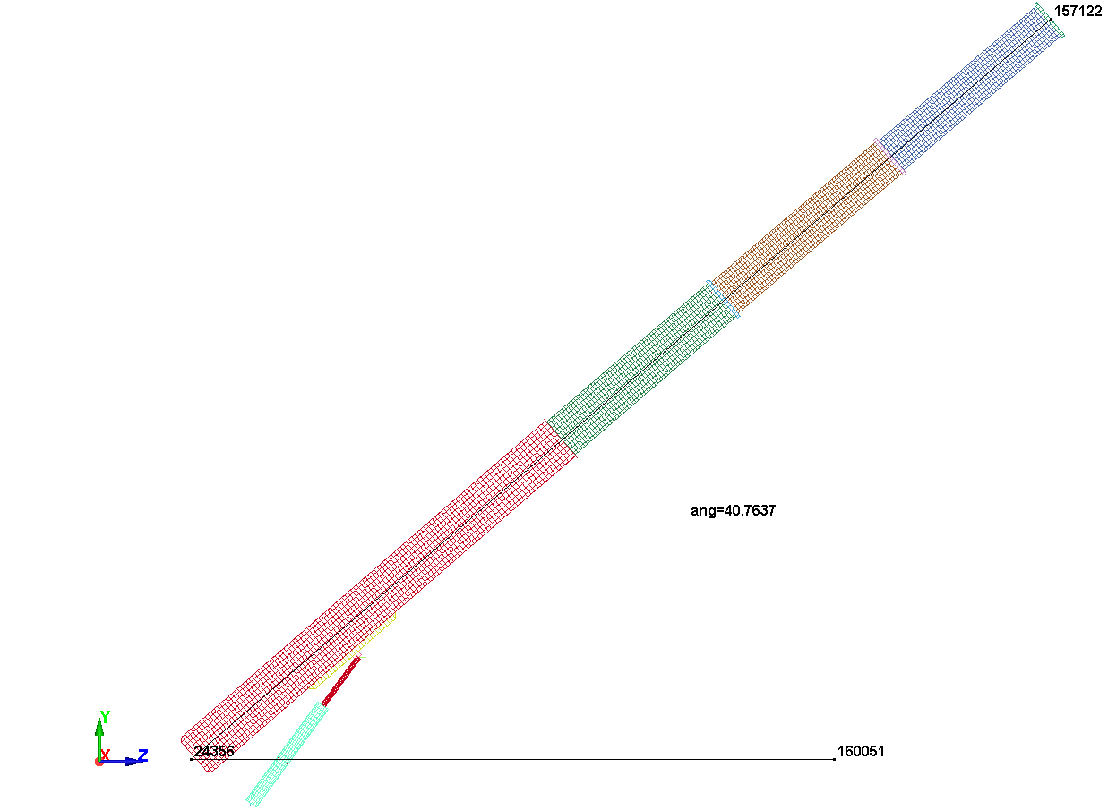
LS_DYNA FILES FOR COSIMULATION (WRAPPER)
0_crane_2d_nofmu.k
0_w_crane_python.py
Initial Crane Angle = 40.7637
etc
etc

Slide 7
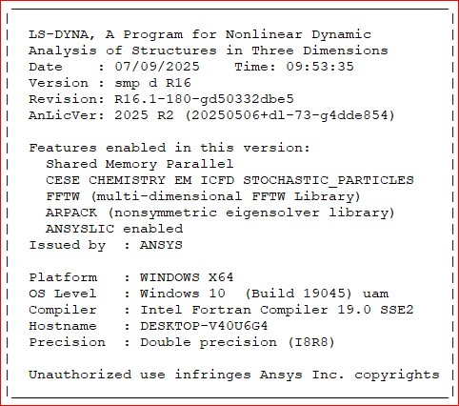
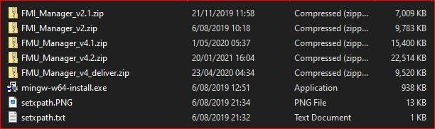

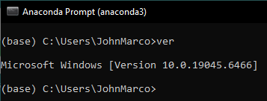
SOFTWARE INSTALLATION
Pyfmi version 2.9.5
Anaconda version 2020.11

Slide 8
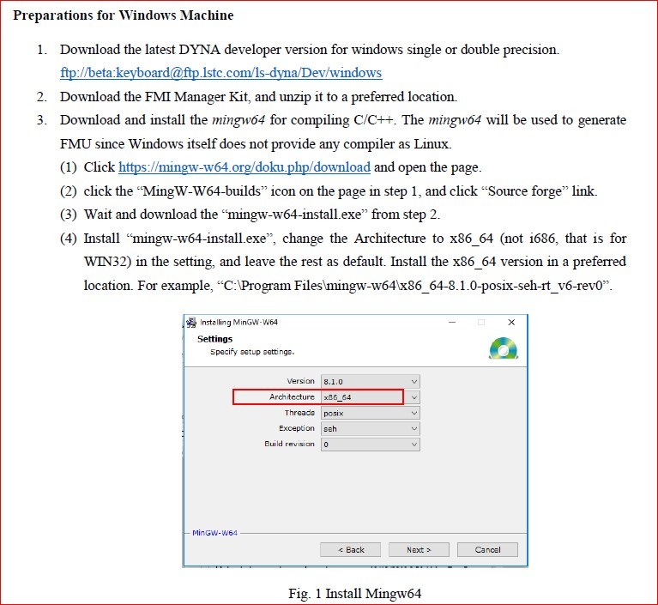
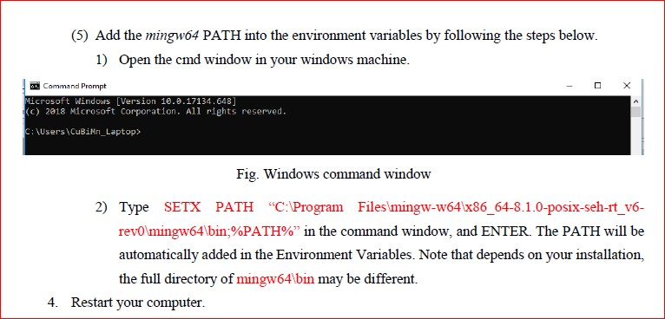
HOW TO INSTALL

Slide 9
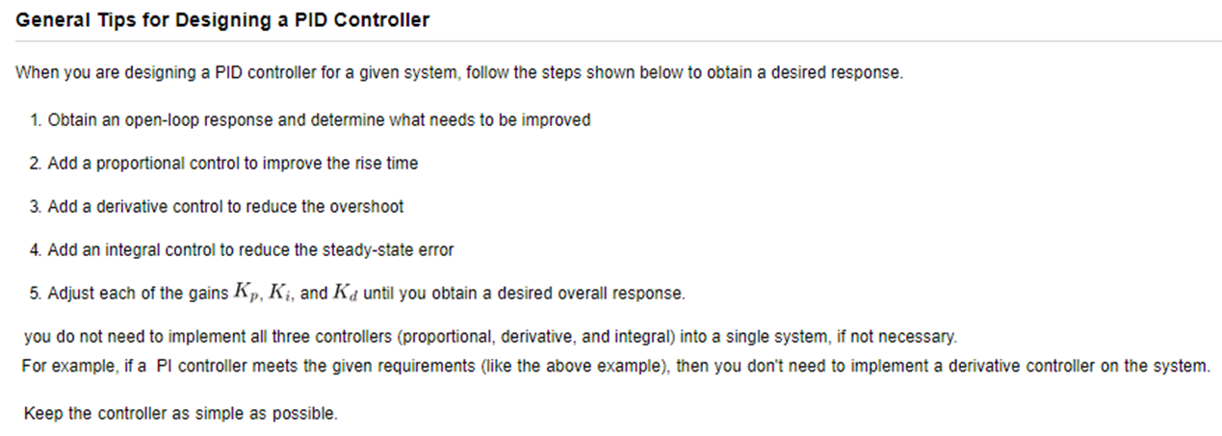
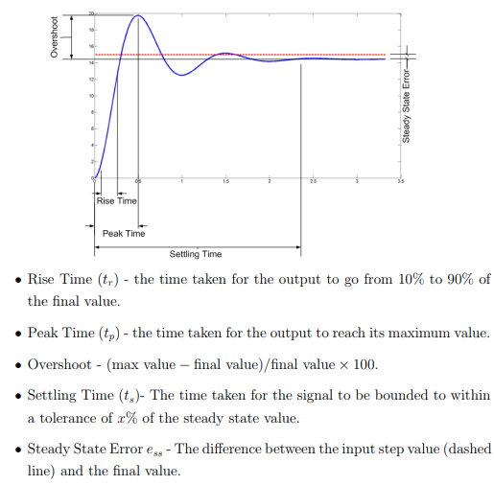
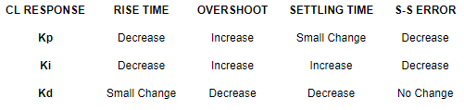

Slide 10
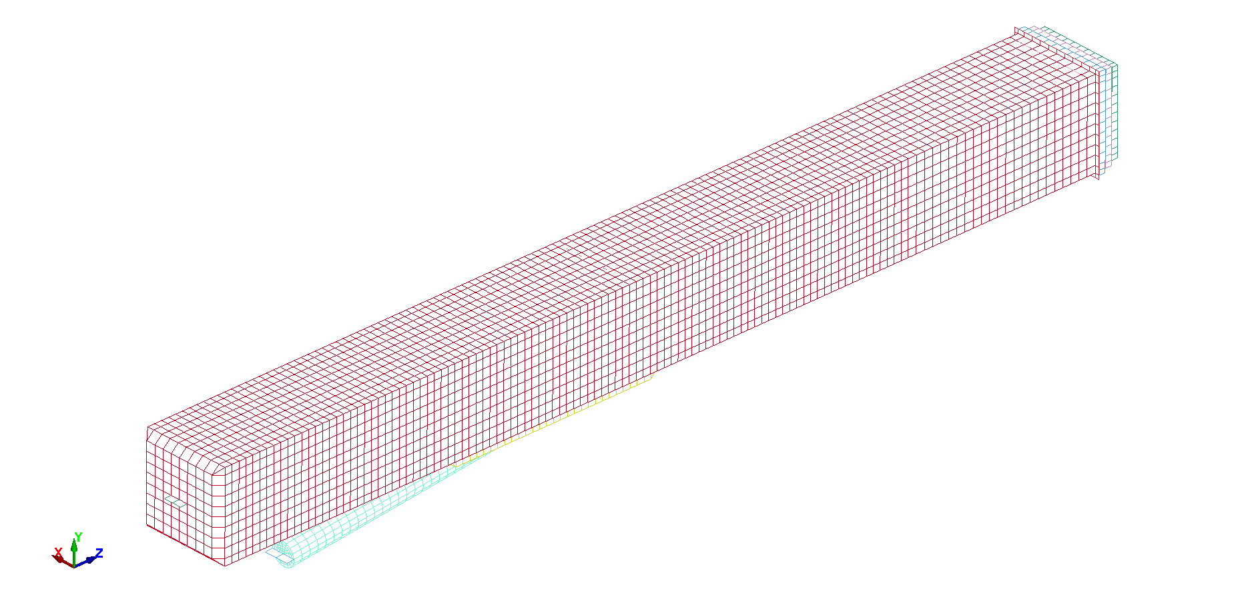
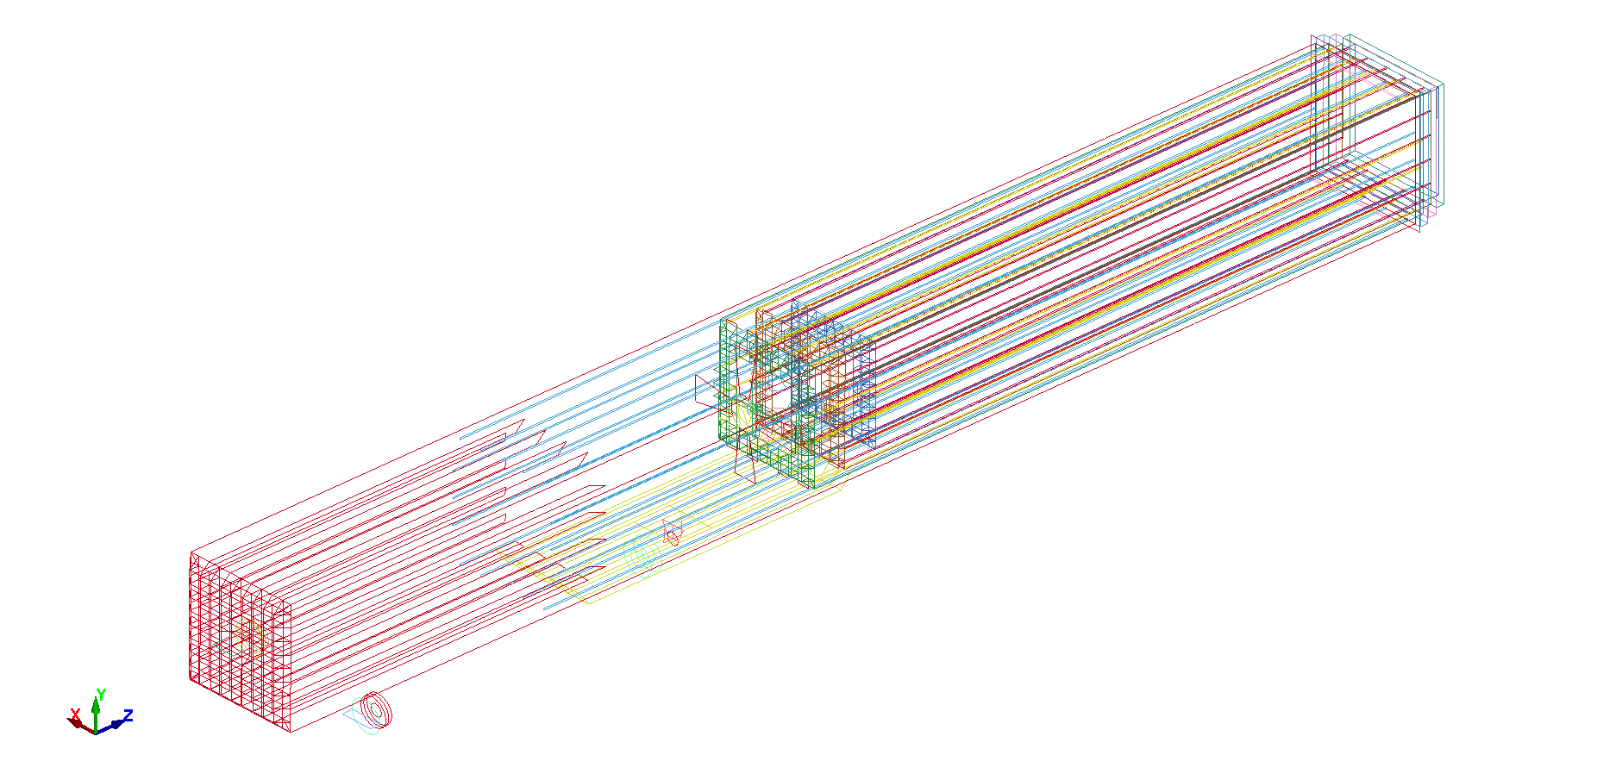
GEOMETRY
(AVERAGE)
BOOM WIDTH HEIGHT THICKNESS LENGTH STIFFENERS WIDTH HEIGHT
0.358 0.358 0.005 3.745 1 0.005 0.005
0.338 0.338 0.005 2.025 2 0.005 0.005
0.318 0.318 0.005 1.950 3 0.005 0.0045
0.299 0.299 0.005 1.876

Slide 11
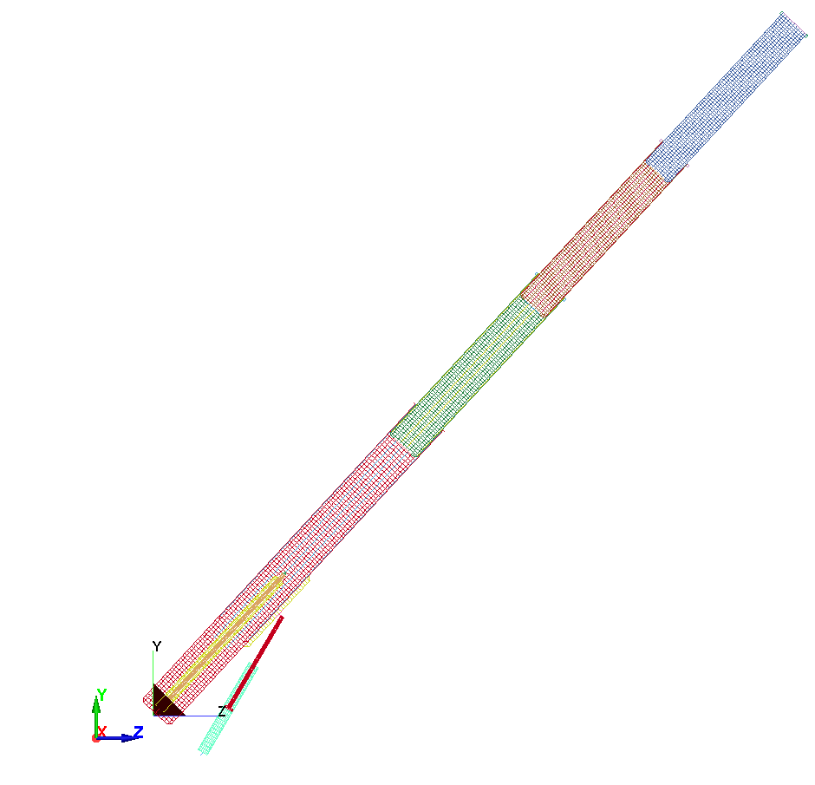
INTERNAL & EXTERNAL PISTON/CYLINDER PARTS
(Not All Parts in Crane Model are used in the Calculations)
Initial Crane Angle = ~40
NB Initial Configuration

Slide 12
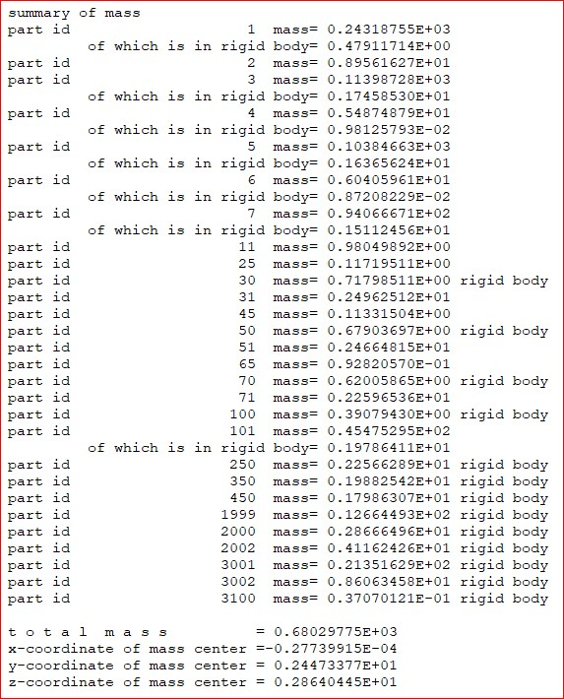
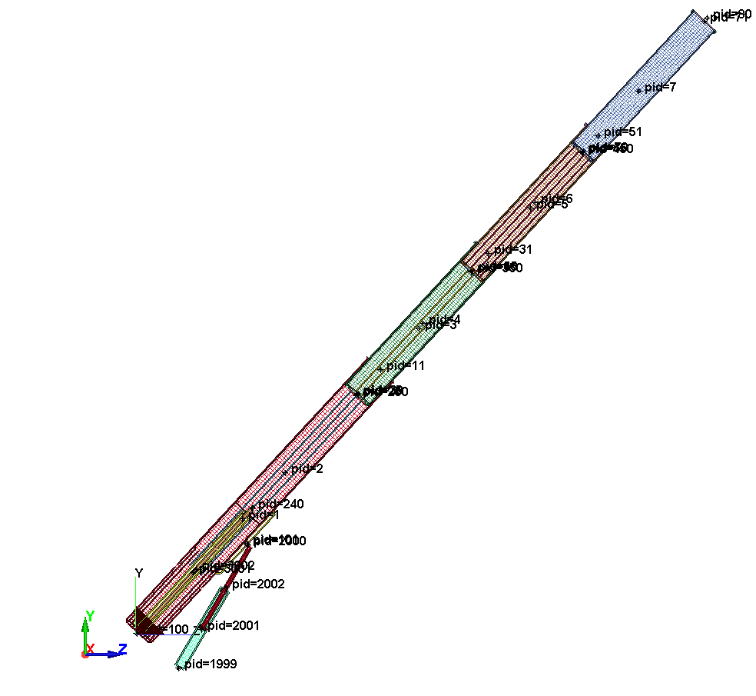
Initial Crane Angle = ~40

Slide 13
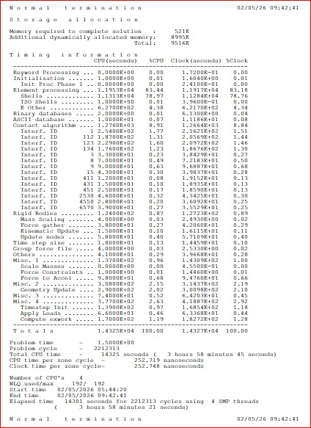
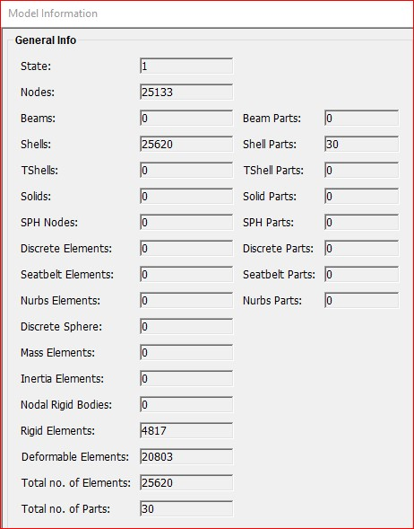
SCENARIO D

Slide 14
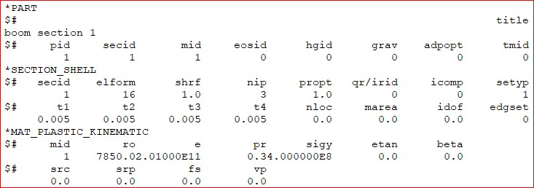
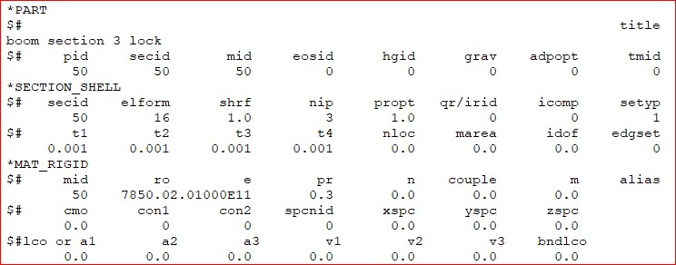
TYPICAL PARTS
ELASTIC/PLASTIC
RIGID

Slide 15
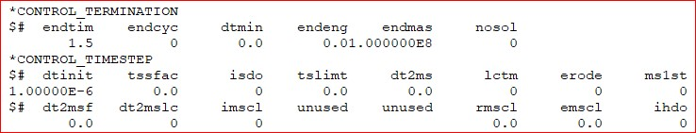
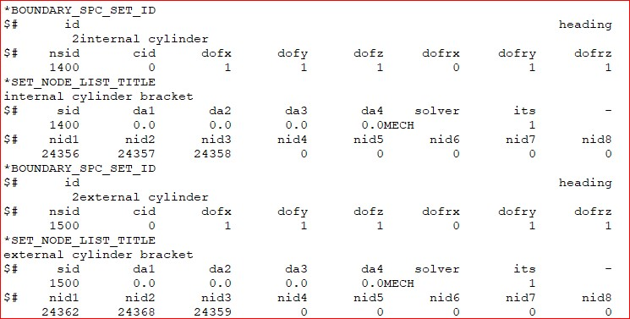
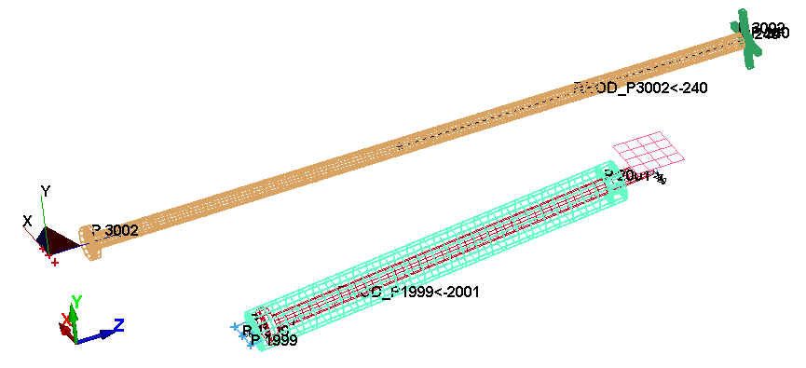
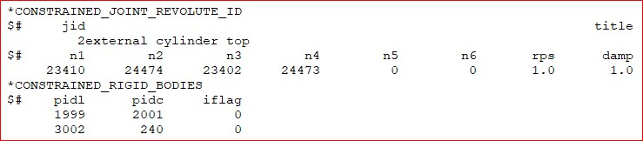
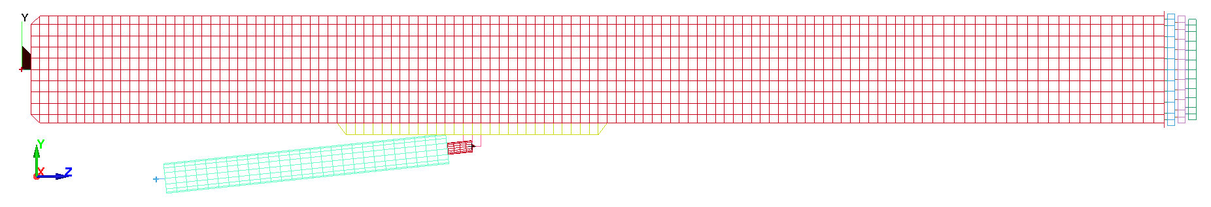
KEYWORDS CONTROL
KEYWORDS BOUNDARY CONDITION
KEYWORDS CONSTRAINTS
NSID 1400
NSID 1500
Actuator

Slide 16
KEYWORDS BOUNDARY PRESCRIBED MOTION
NB Both Internal & External Piston are not Functional
Initial Crane Angle = ~40

Slide 17
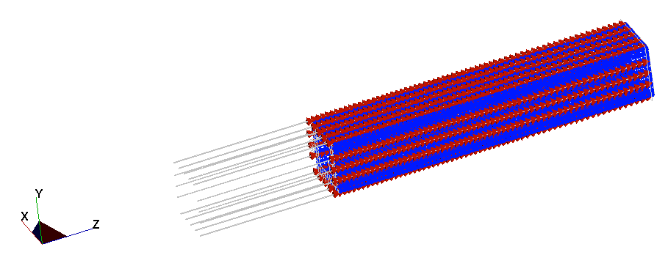
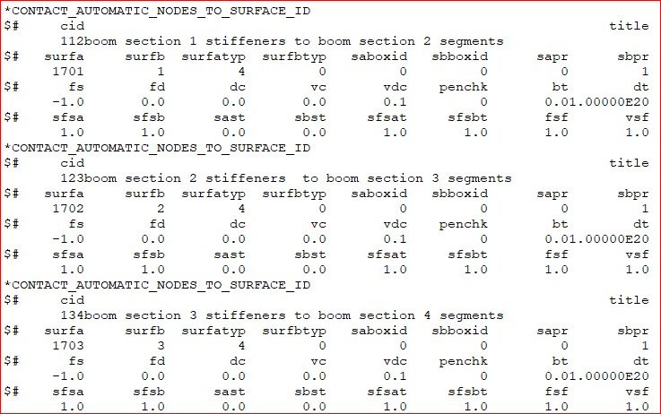
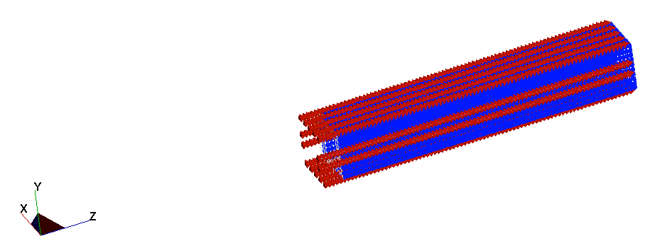
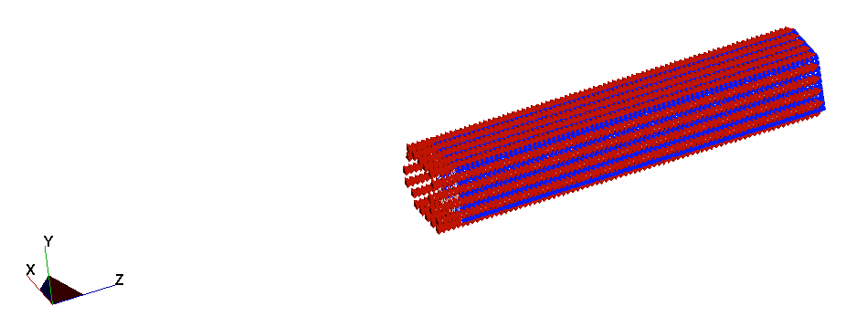
KEYWORDS CONTACT 1
Boom 2
CONTACT 112
Boom 1 Stiffeners
Boom 3
CONTACT 123
Boom 2 Stiffeners
CONTACT 134
Boom 4
Boom 3 Stiffeners

Slide 18
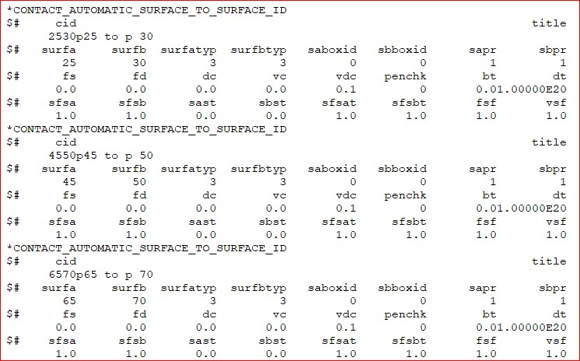
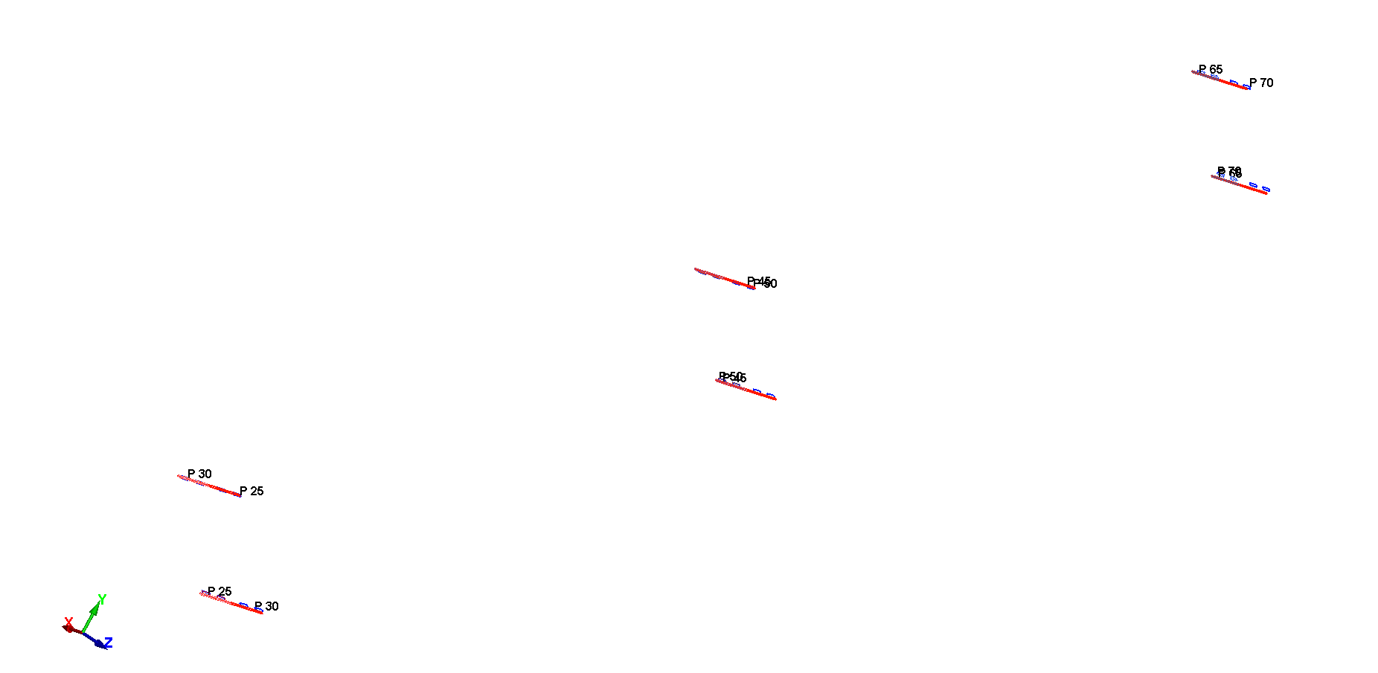

KEYWORDS CONTACT 3
Initial Crane Angle = 40.7637
CONTACT 6570
CONTACT 4550
CONTACT 2530

Slide 19





KEYWORD GRAVITY & HOOK LOADS
Hook Load = 400N
LOADING CURVE
Hook
Load
Gravity Load
Initial Crane Angle = ~40

Slide 20



RESULTS NODE TRACE
Initial Crane Angle = ~40
Fixed
Angle Vibration About Initial Crane Angle
Actuator Holds Up the Crane Booms
Fixed

Slide 21

BOOM ROTATION & EXTENSIONS
Hook Load (400N)
NB Crane Booms Fixed in Rotation and Extension
Initial Crane Angle = ~40
Boom
Extension
Boom
Rotation
Actuator Controls Boom Angle

Slide 22




BOUNDARY CONSTRAINT FORCES
Y FORCES
FILTERED BW 60Hz
Z FORCES
FILTERED BW 60Hz
TOTAL FORCES
FILTERED BW 60Hz
Initial Crane Angle = ~40

Slide 23


CONTACTS
These Contacts are between a Boom Section and a Boom Stiffener
Boom 4
Boom 3 Stiffeners
Boom 3
FILTERED BW 60Hz
Boom 2
Boom 2 Stiffeners
Boom 1 Stiffeners
Initial Crane Angle = ~40

Slide 24



CONTACTS
CONTACT 112
NB These Contacts prevent The Boom Sections from Retracting
FILTERED BW 60Hz
Boom 4 Lock
Boom 3 Stiffeners Max Limit
(CONTACT 134)
CONTACT 123
Boom 3 Lock
Boom 2 Stiffeners Max Limit
(CONTACT 123)
Boom 2 Lock
CONTACT 134
Boom 1 Stiffeners Max Limit
(CONTACT 112)
Initial Crane Angle = 40.7637

Slide 25



VON MISES STRESS
Hook Load (400N)

Slide 26



ACTUATOR Y DIRECTION FORCE
Actuator Force (P Controlled) vs Time
FORCE = PCOEF1*(CY160000-CY24475)
DISPLACEMENT
(CY160000 – CY24475)
ACTUATOR FORCE
(PCOEF1 = 2.0E+06)
P Controller Point
Set Point
Actuator

