Slide 1
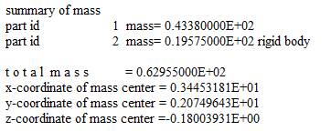
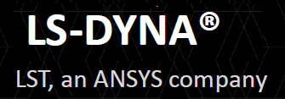
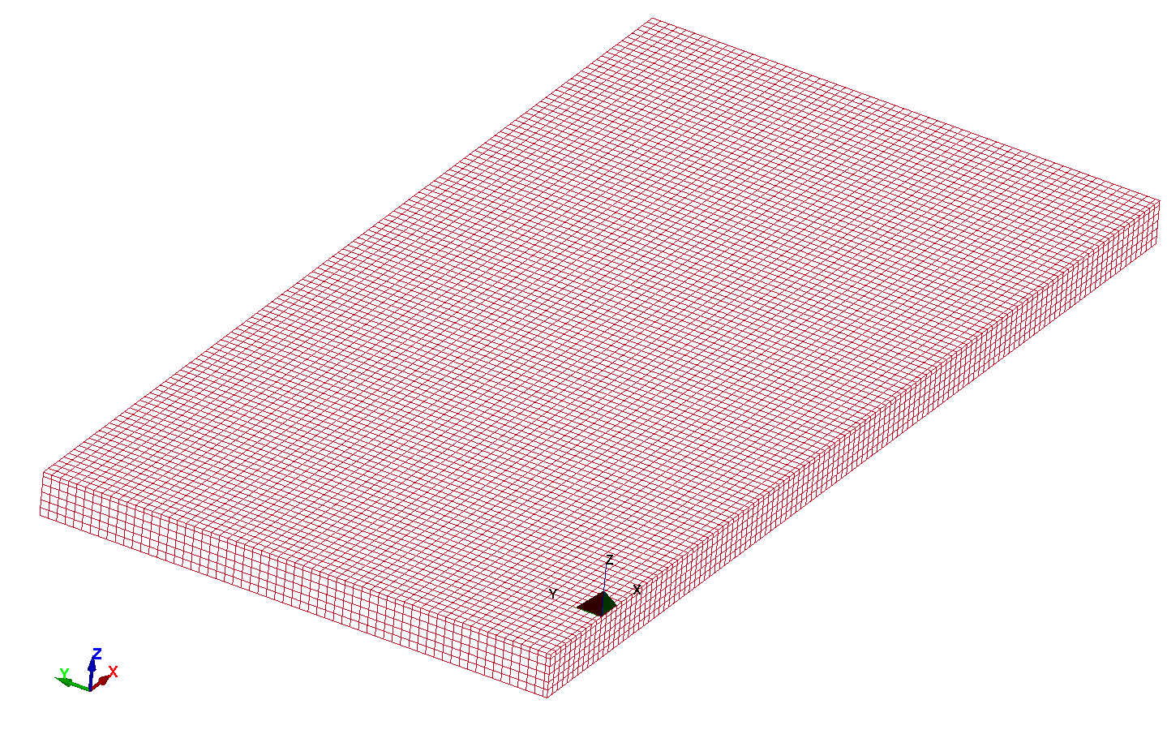

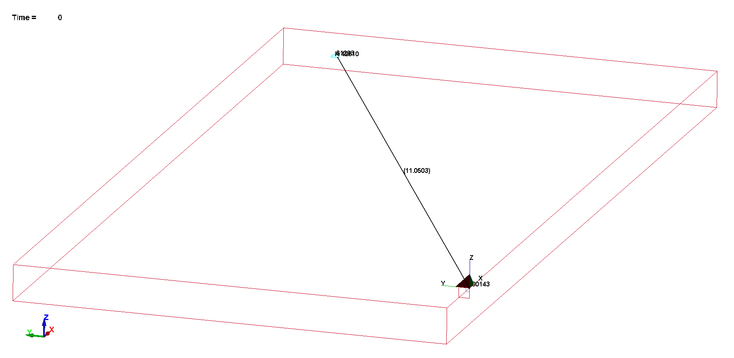

NOISE PLATE CONTROL 3D CSYS
(AN TIME DOMAIN ACOUSTIS ANALYSIS)
NB
¼ model
Geometry
12 X 6 X 0.5
Point Of Interest
(TARGET)
Vibrating Rigid Plate
(SOURCE)
UNITS : m:kg:s:Pa:N:K
(WRAPPER SCENARIO)
Plate X Motion

Slide 2
SCENARIO FMU LS_DYNA PYTHON PYTHON RMS
TIME STEP TIME STEP TIME STEP
MODEL 11 NO 9.73e-05 N/A N/A
MODEL 11 A YES 9.73e-05 0.001 0.100
MODEL 11 B YES 9.73e-05 0.001 0.050
MODEL 11 C YES 9.73e-05 0.001 0.025
NB
CRITERIA Pressure < 80dB
Run Time 10.0s
Speed Sound in AIR = 340 m/s
Distance Source to Target = 11.05m
Time Taken to Travel from Source to Target = 32.5 ms
Point Of Interest
(TARGET)
Vibrating Rigid Plate
(SOURCE)
Plate X Motion

Slide 3
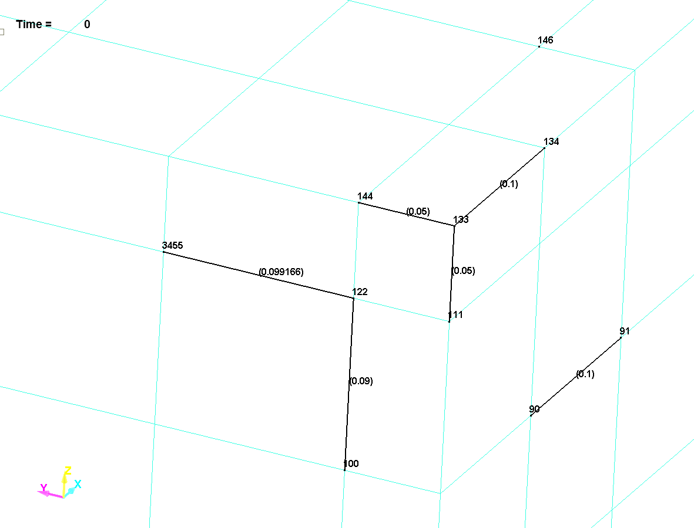

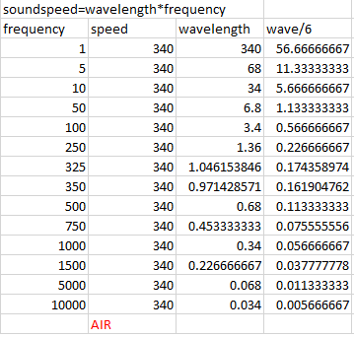
NB
Original model from Dr. Yun Huang (SYSOPSYS)
Shortest Length (X) = 0.1m
Shortest Length (Y) = 0.05m
Time Step = 9.73e-05(s)
Time Duration = 10.0s
AIR MODEL

Slide 4
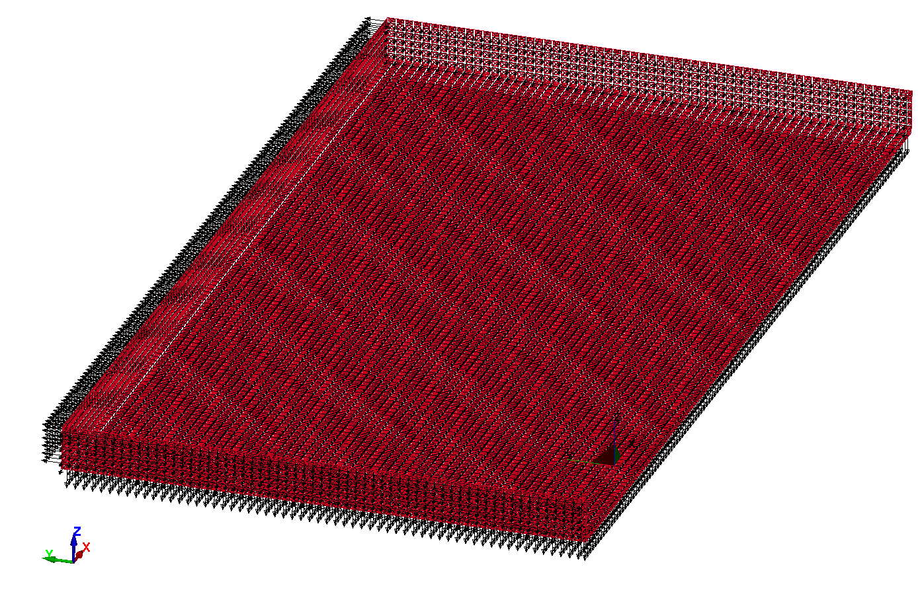

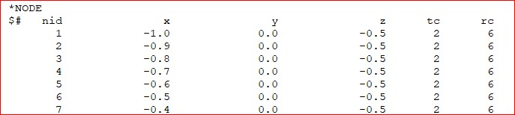
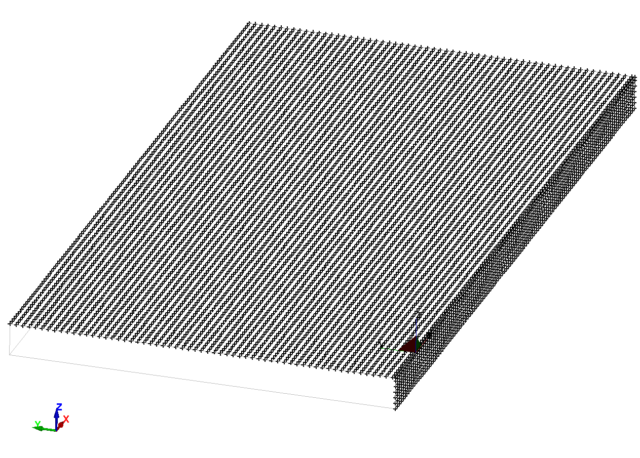
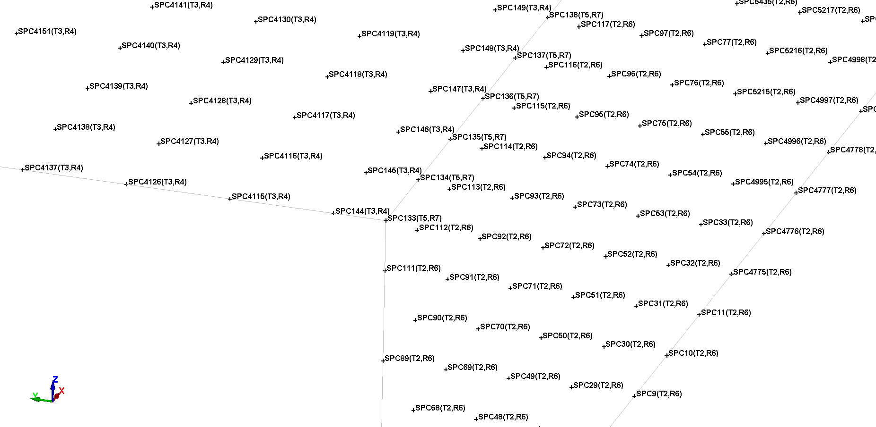
NON REFLECTING BOUNDARIES
NB ¼ MODEL
NODE SPC
etc
SYMMETRY PLANE XZ
SYMMETRY PLANE XY

Slide 5
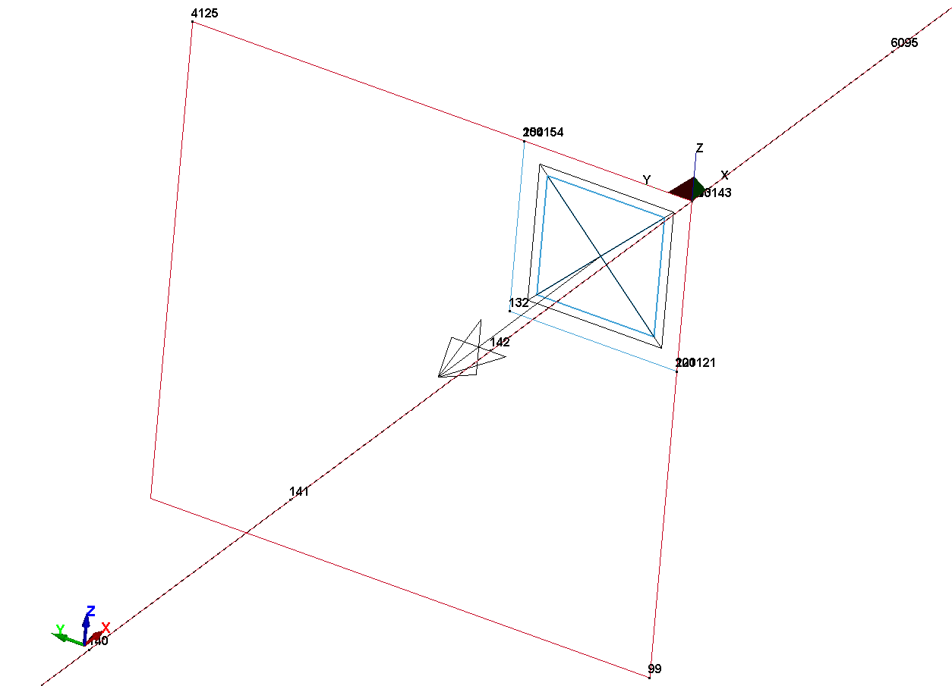
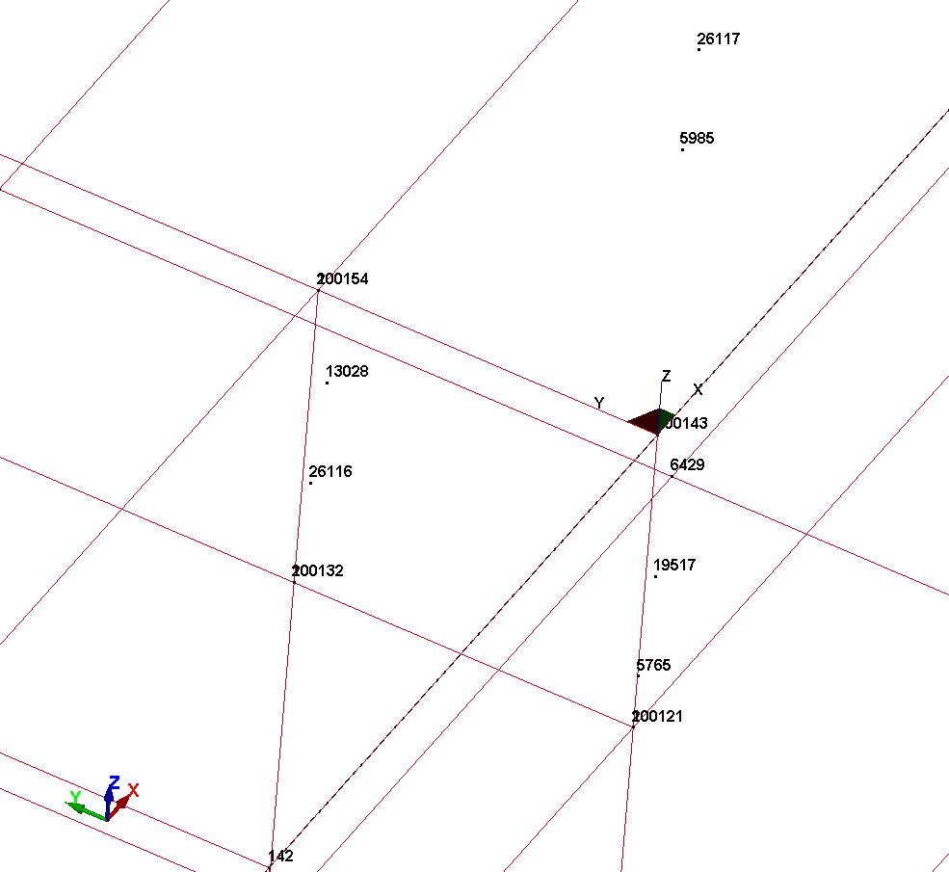
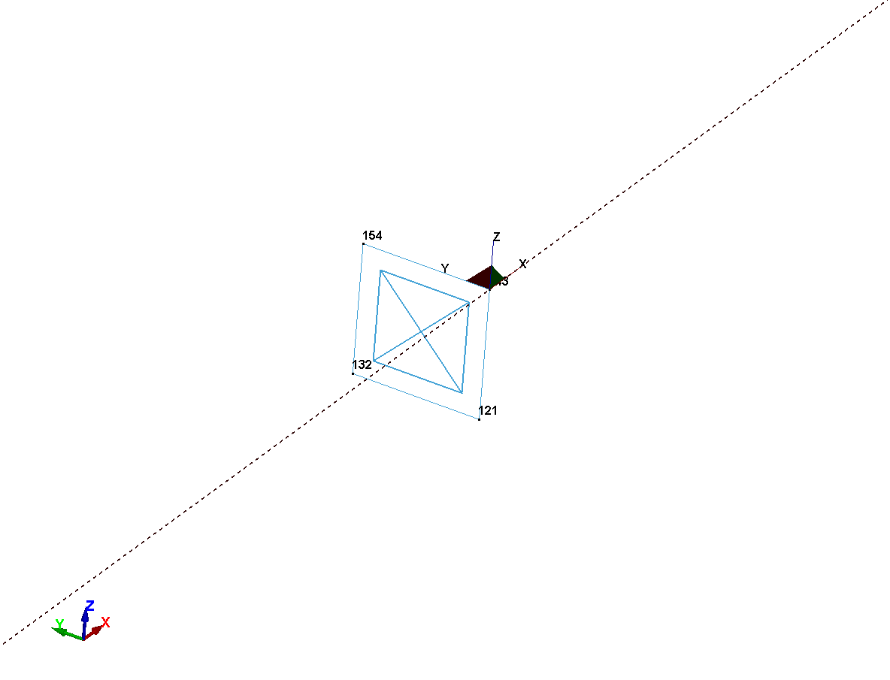
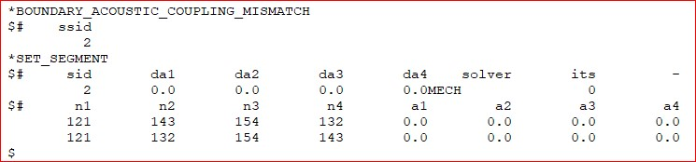
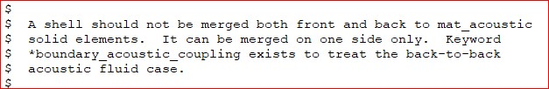
NB
Fluid on both sides of the plate
Rigid Plate PID=2
Vibrating in the air

Slide 6

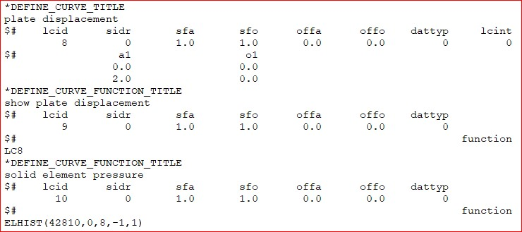

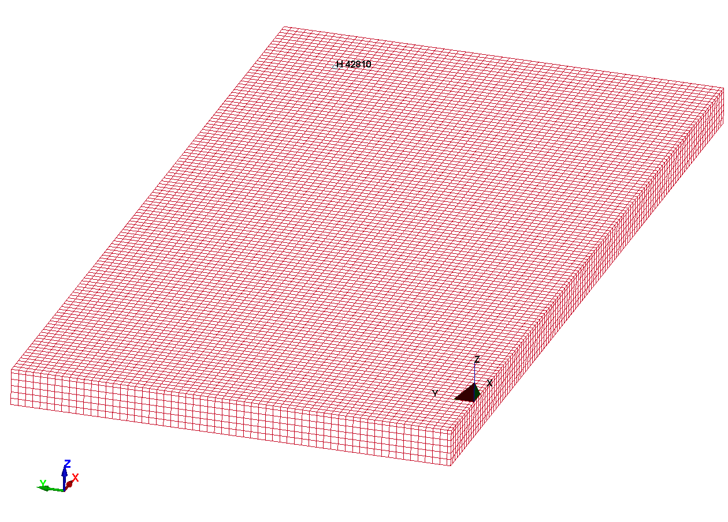
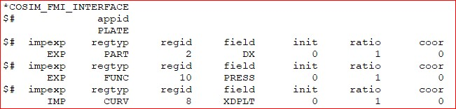
(PYTHON)
Location of Interest SPL to be determined
Distance from Source ~11.0
TARGET
(LS_DYNA)
LSDYNA (EXP:FUNC) Pressure TO PYTHON
PYTHON (IMP:CURV) PLATE X DISPLACEMENT TO LSDYNA
SOURCE
Rigid Plate PID=2
Vibrating in the air

Slide 7
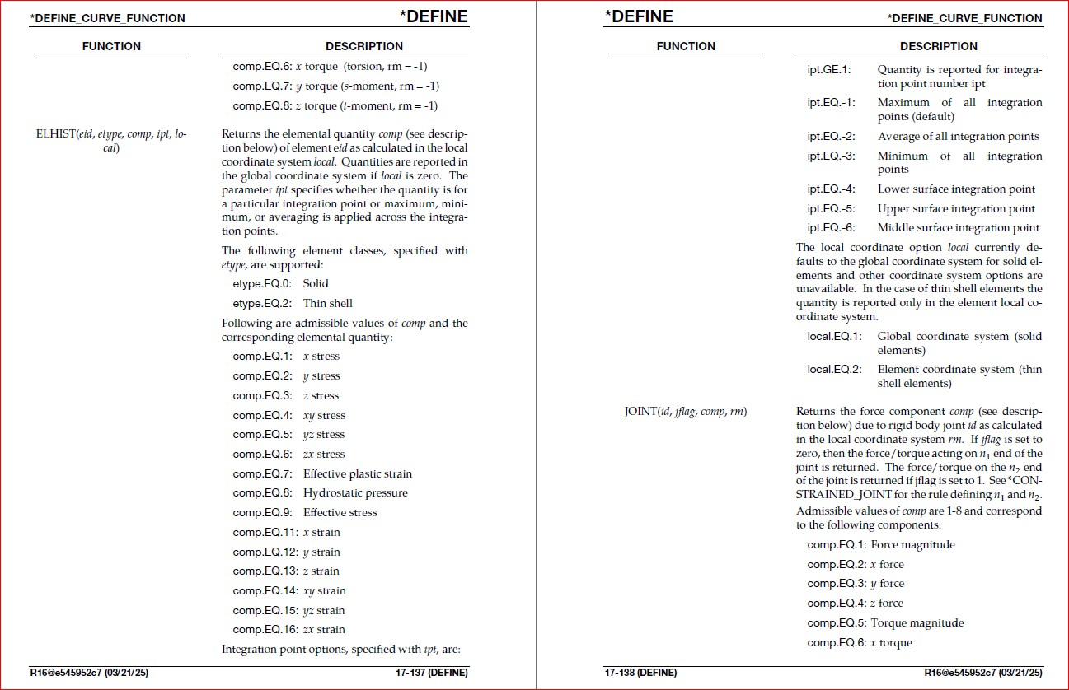
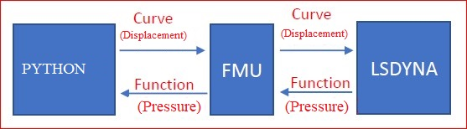

Slide 8
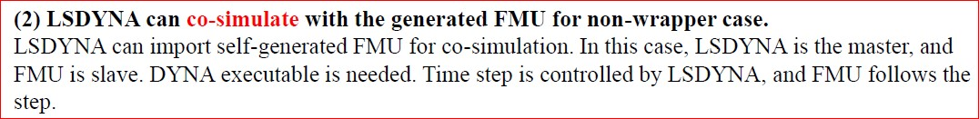
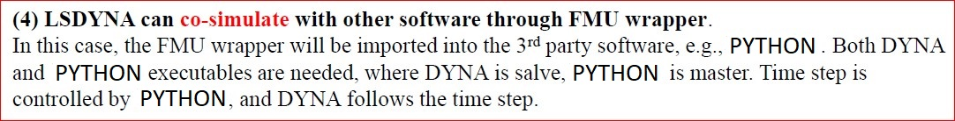
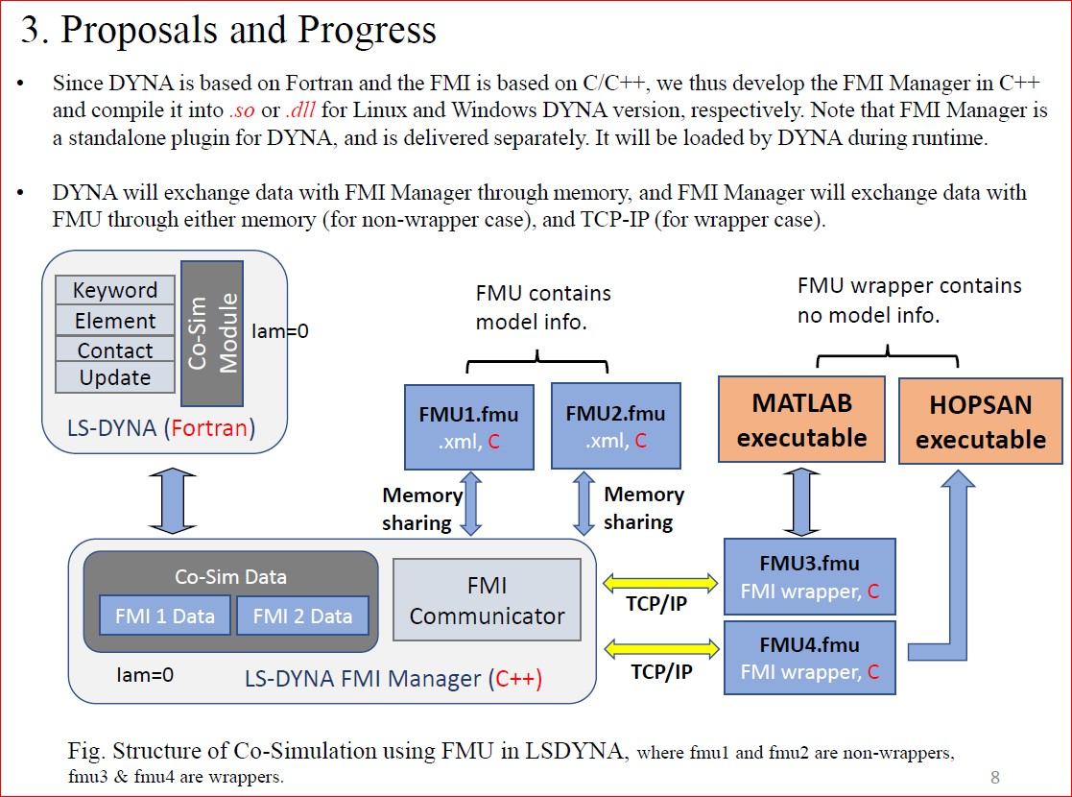
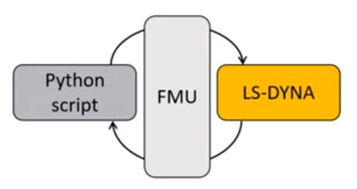
COSIMULATION TERMINOLGY
NON-WRAPPERS
NB. WRAPPER SCENARIO
WRAPPERS
PRIMARY
(MASTER)
SECONDARY
(SLAVE)

Slide 9
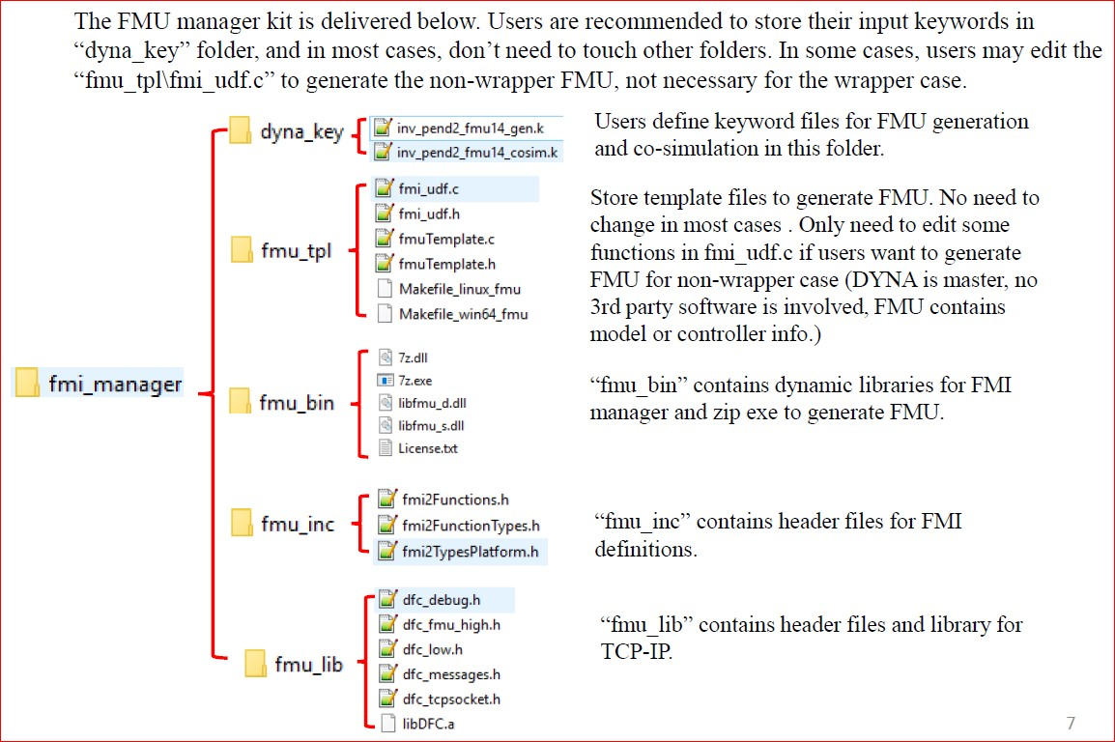
plate

Slide 10
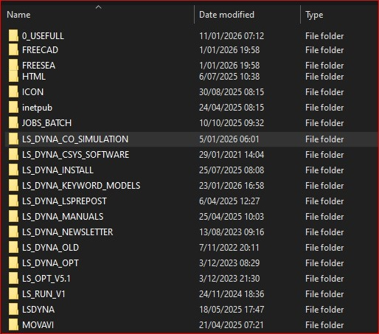
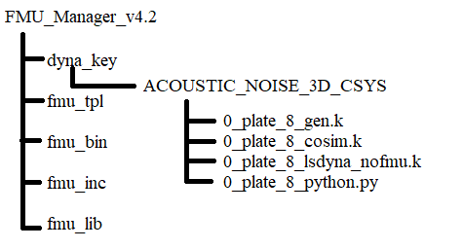
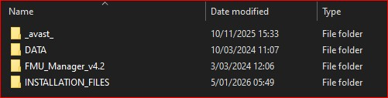
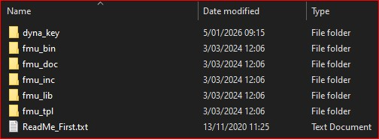
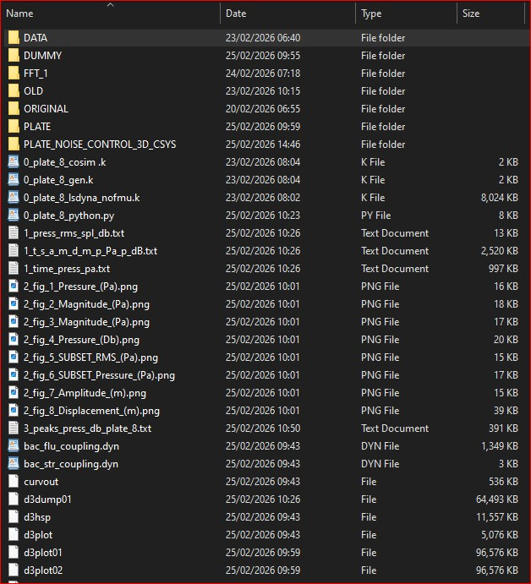
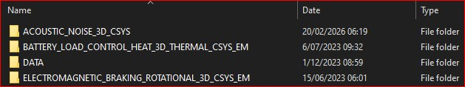
FOLDER STRUCTURE

Slide 11
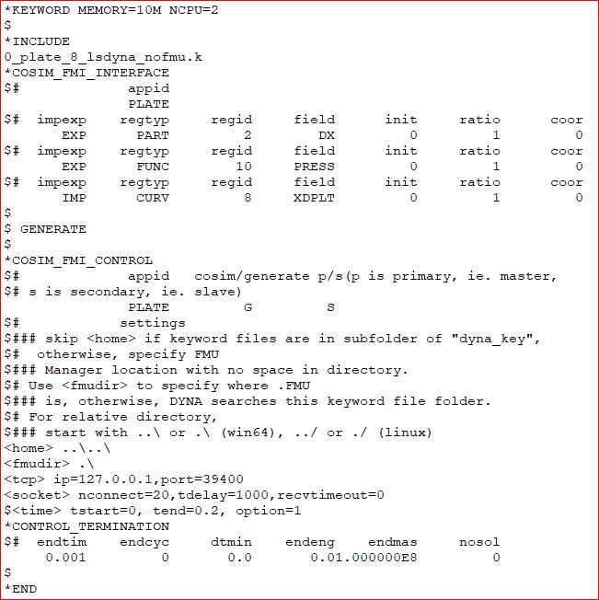
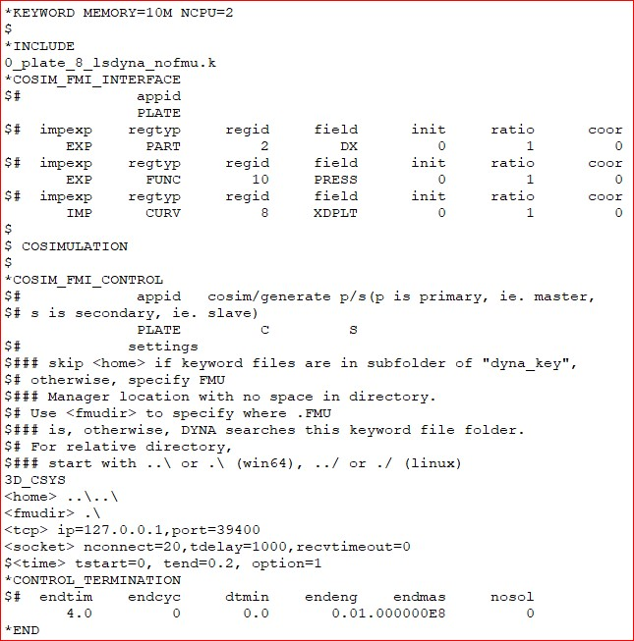
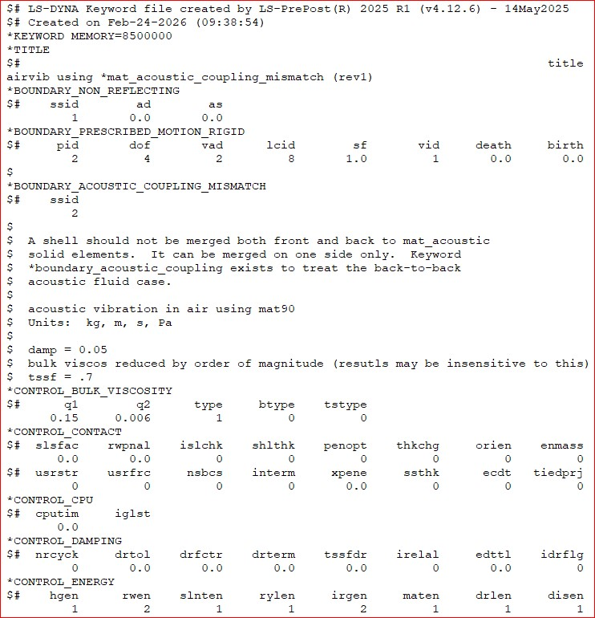
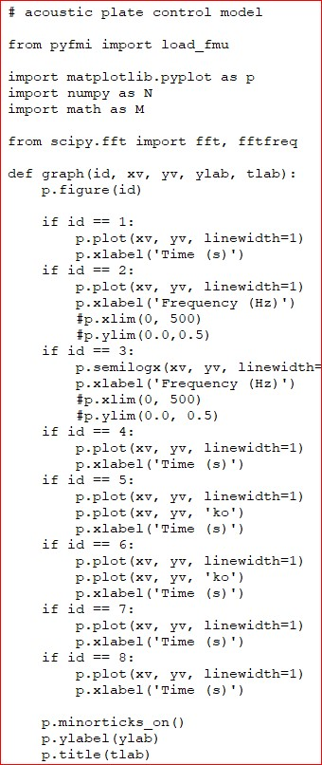
LS_DYNA FILES FOR COSIMULATION (WRAPPER)
0_plate_11_gen.k
0_plate_11_cosim.k
0_plate_11_lsdyna_nofmu.k
0_plate_11_python.py
etc
etc

Slide 12
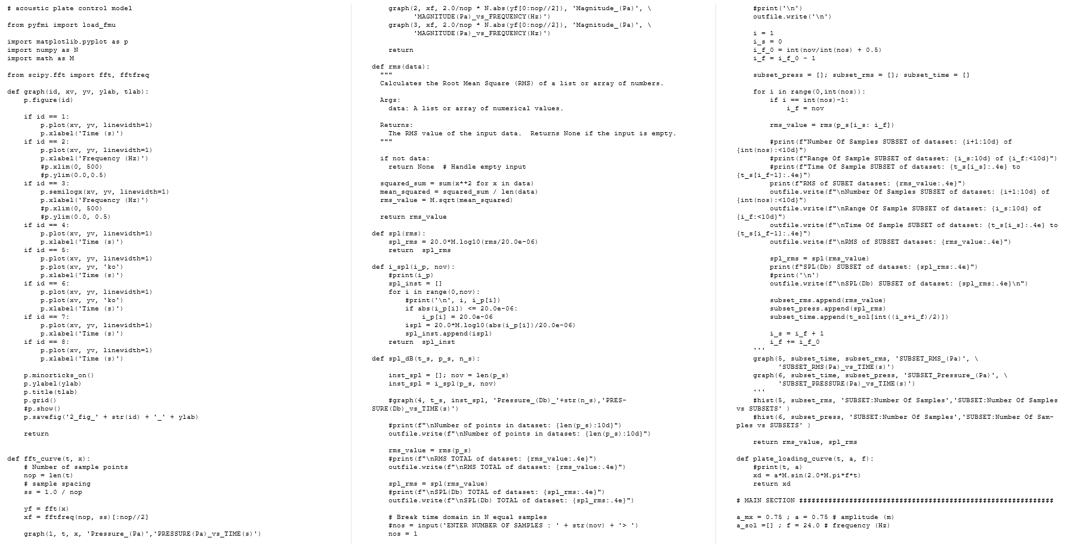
PYTHON CODE

Slide 13
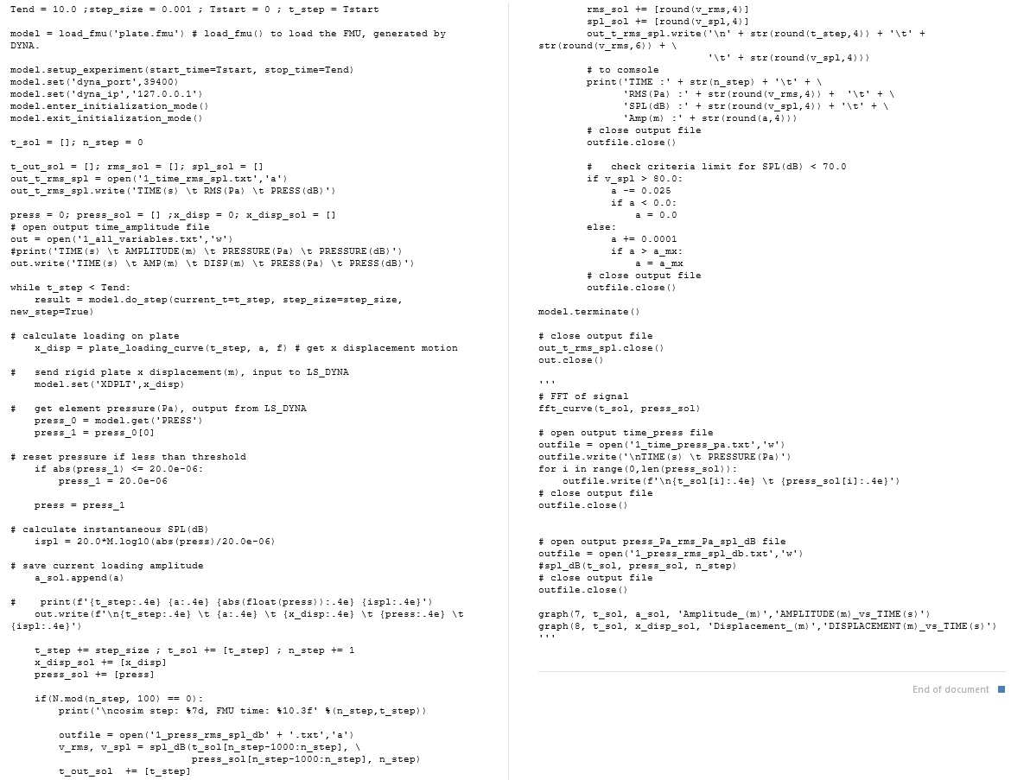

Slide 14
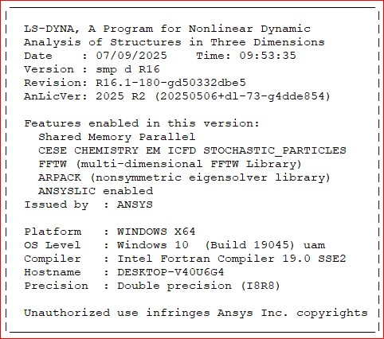
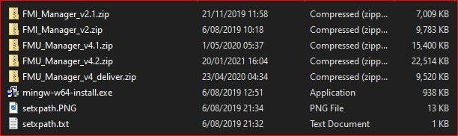

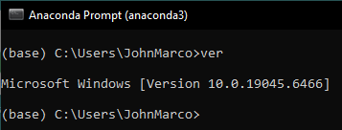
SOFTWARE INSTALLATION
Pyfmi version 2.9.5
Anaconda version 2020.11

Slide 15
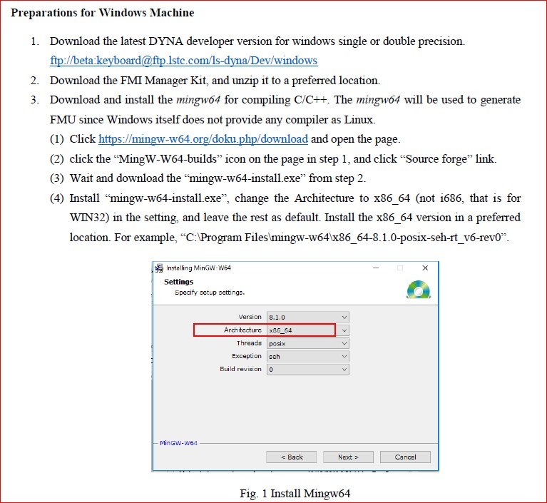
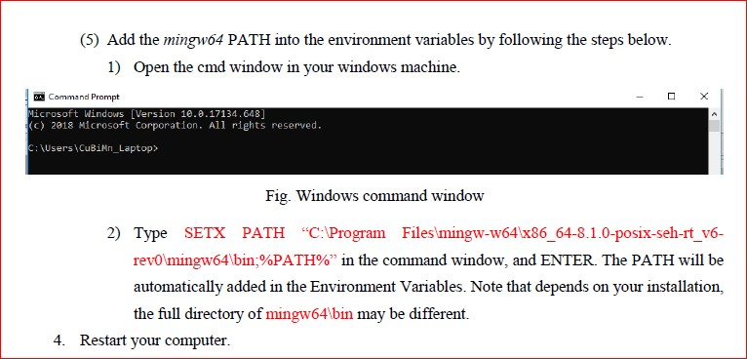
HOW TO INSTALL

Slide 16
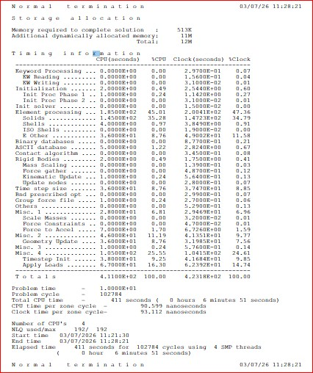
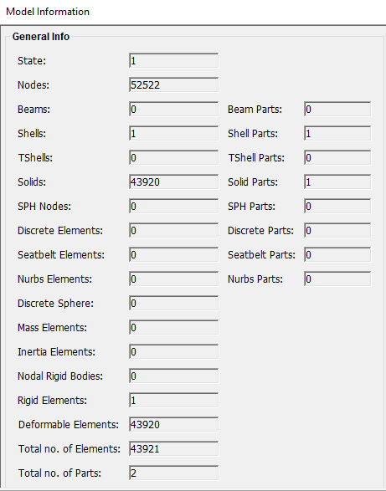
RUN TIME
MODEL INFO

Slide 17
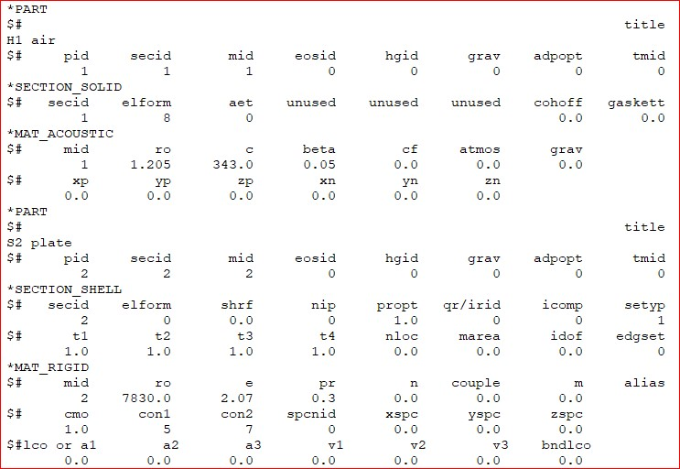
TYPICAL PARTS
AIR
PLATE

Slide 18
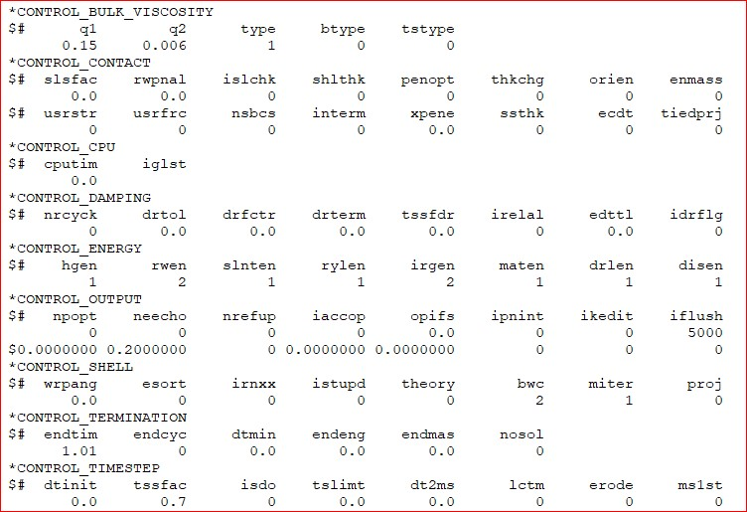
KEYWORDS CONTROL

Slide 19
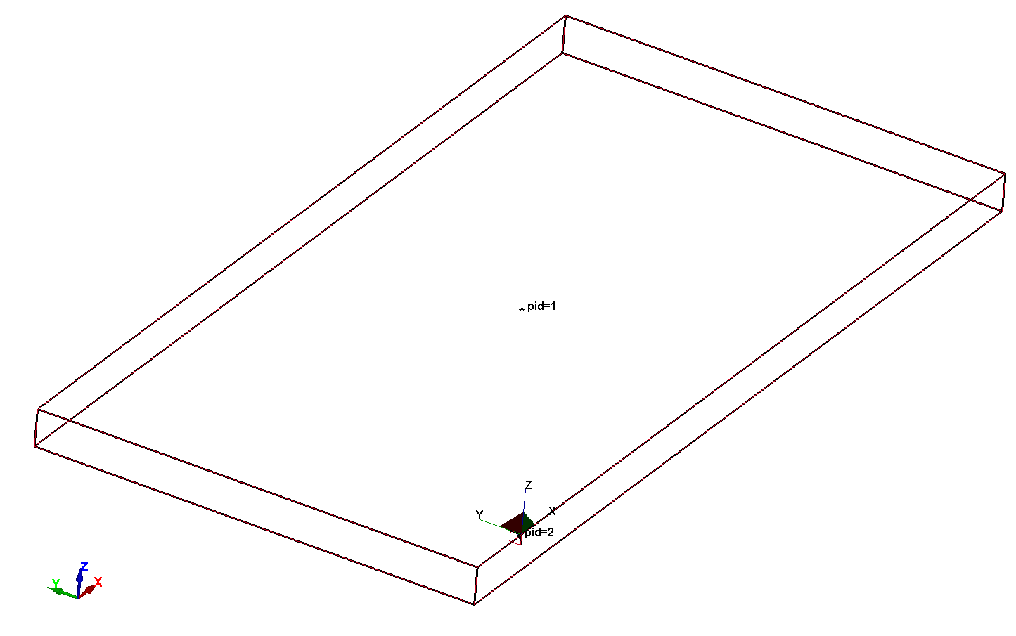
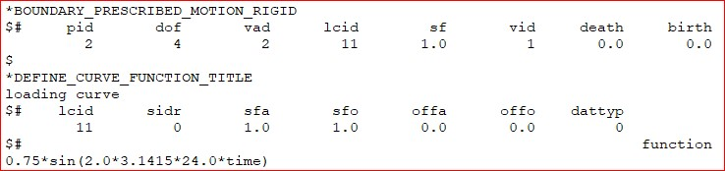
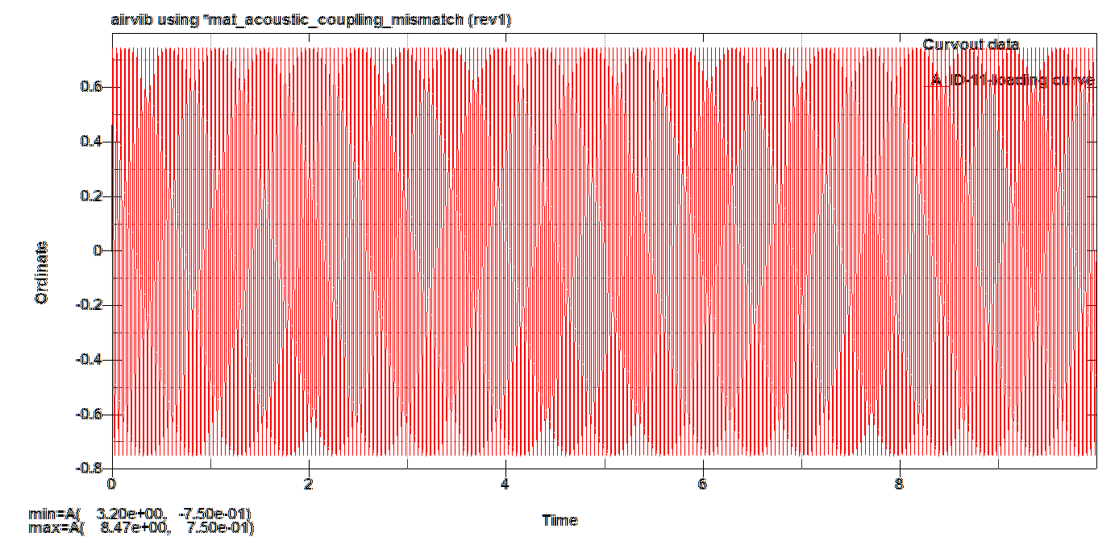
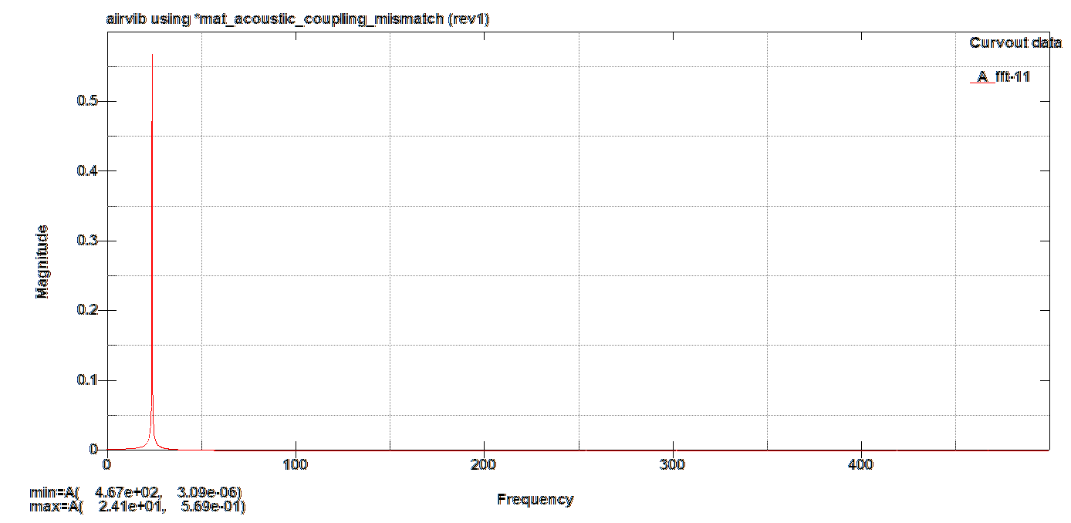
LOADING CURVE PLATE
MODEL 11
Plate
X Prescribed Motion
(FREQUENCY[Hz])
(AMPLITUDE[m])

Slide 20


RESULTS : PLATE X DISPLACEMENT
MODEL 11
Plate
X Prescribed Motion
FFT

Slide 21




RESULTS : PRESSURE
MODEL 11
ORIGINAL PRESSURE
FILTERED (BW 30Hz) PRESSURE
FFT
FFT

Slide 22




RESULTS : PRESSURE
MODEL 11
Pressure(dB) Response @ TARGET Due to Steady State Excitation @ SOURCE
FILTERED (BW 30Hz)PRESSURE

Slide 23


RESULTS : PRESSURE
MODEL 11
Pressure(dB) Response @ TARGET Due to Steady State Excitation @ SOURCE
FILTERED (BW 30Hz) PRESSURE

Slide 24
RESULTS : PRESSURE
MODEL 11A
Pressure(dB) Response Due to Cosimulation @ TARGET
Pressure(Pa) averaged over time interval 0.1s
Pressure(Pa) vs Time(s)
Delta Time
(0.100s)
RMS Pressure(Pa)
vs
Time(s)
SPL Pressure(dB)
vs
Time(s)

Slide 25
MODEL 11A
Pressure(dB) Response Due to Cosimulation @ TARGET

Slide 26
RESULTS : PRESSURE
MODEL 11B
Pressure(Pa) averaged over time interval 0.05s
Pressure(dB) Response Due to Cosimulation @ TARGET
Pressure(Pa) vs Time(s)
Delta Time
(0.050s)
RMS Pressure(Pa)
vs
Time(s)
SPL Pressure(dB)
vs
Time(s)

Slide 27
MODEL 11B
Pressure(dB) Response Due to Cosimulation @ TARGET

Slide 28
RESULTS : PRESSURE
MODEL 11C
Pressure(dB) Response Due to Cosimulation @ TARGET
Pressure(Pa) averaged over time interval 0.025s
Pressure(Pa) vs Time(s)
Delta Time
(0.025s)
RMS Pressure(Pa)
vs
Time(s)
SPL Pressure(dB)
vs
Time(s)

Slide 29
MODEL 11C
Pressure(dB) Response Due to Cosimulation @ TARGET

